Slide 1
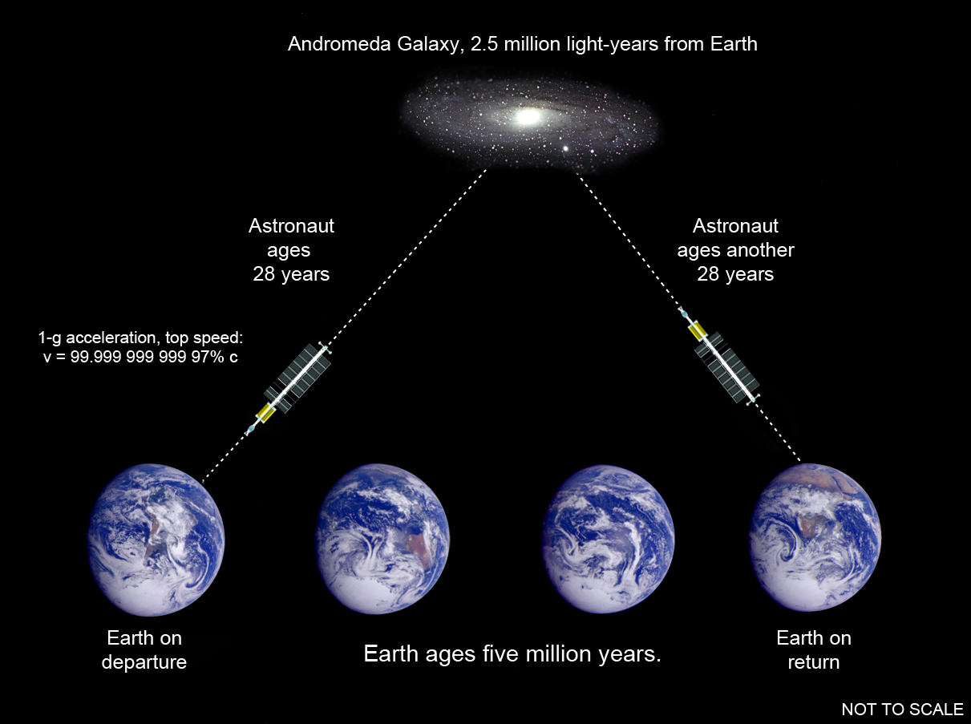
Notes:
1

Slide 2
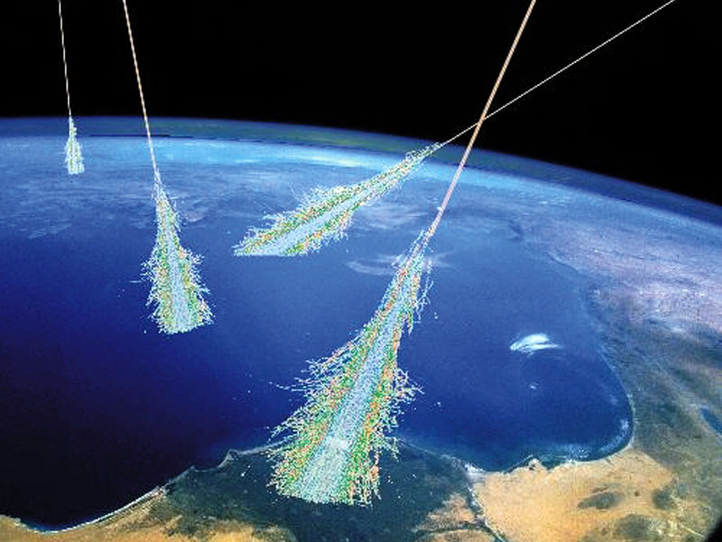
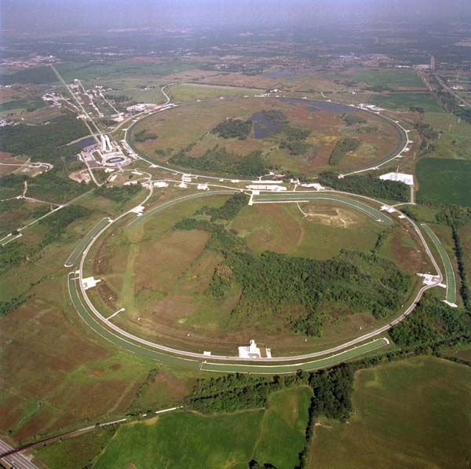
Einstein’s special theory of relativity is now well observed.
Cosmic rays
High-energy physics

Slide 3
…One day in the late 1940s, [some scientist],
stood and watched a number of undergraduates in physics
as they came bursting out of a lecture. They were, he was
later to recall, “beyond all doubt the noisiest, rowdiest,
most active and most intellectually alert” of all the
Institute’s budding talents…[the scientist] stopped one of
them as he charged past and asked: “How did it go?”
“Wonderful!” came the reply. “Everything we knew
about physics last week isn’t true!”
– The Scientist, by Henry Margenau and
David Bergamini, Life Science Library, 1966.

Slide 4
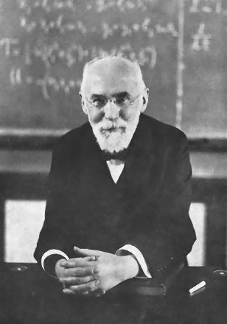
Hendrik
Lorentz

Slide 5
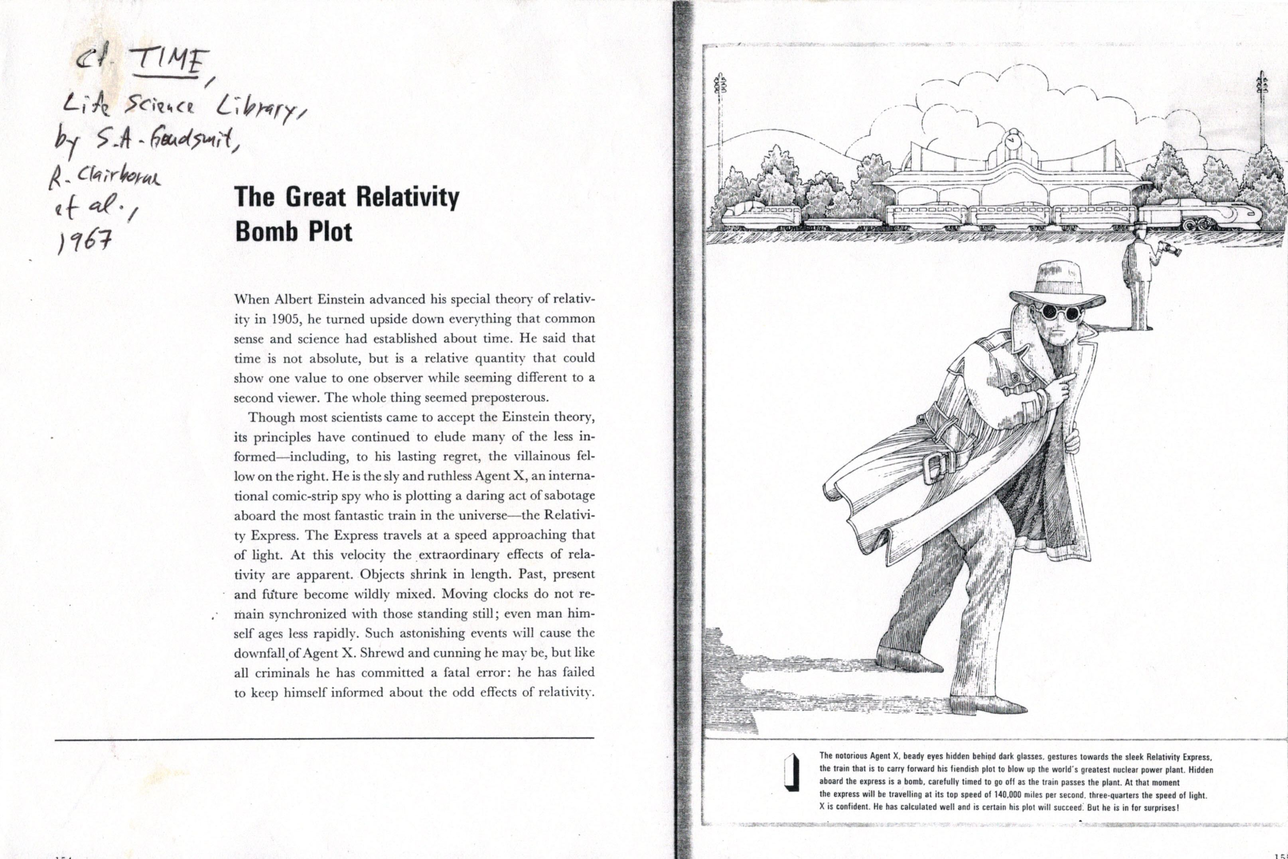

Slide 6
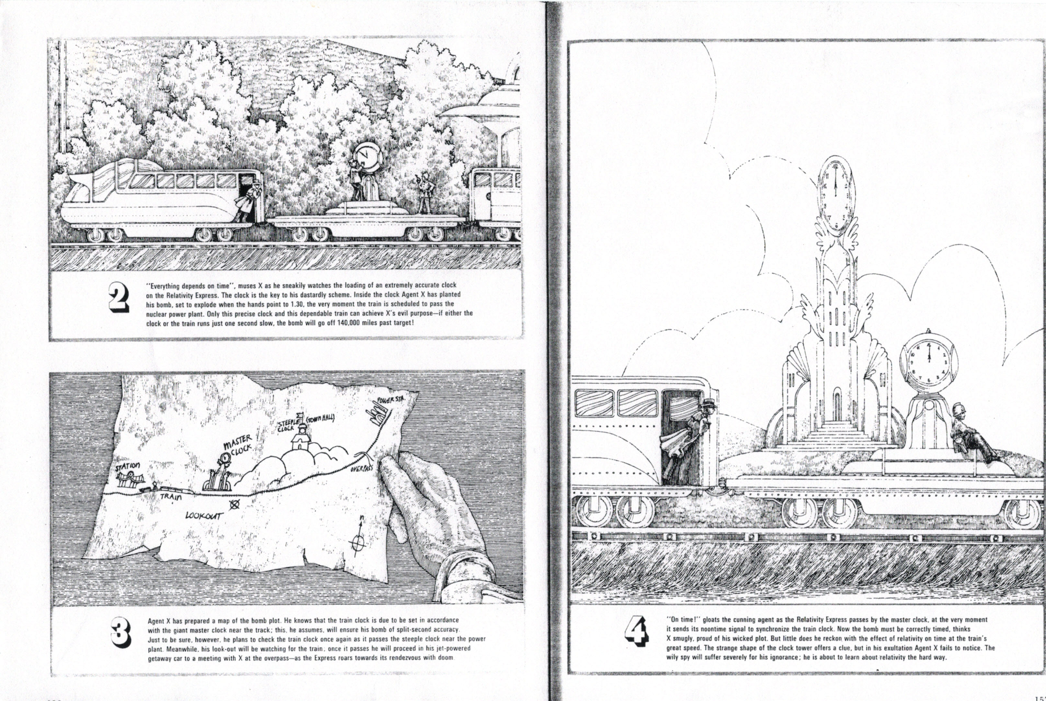

Slide 7
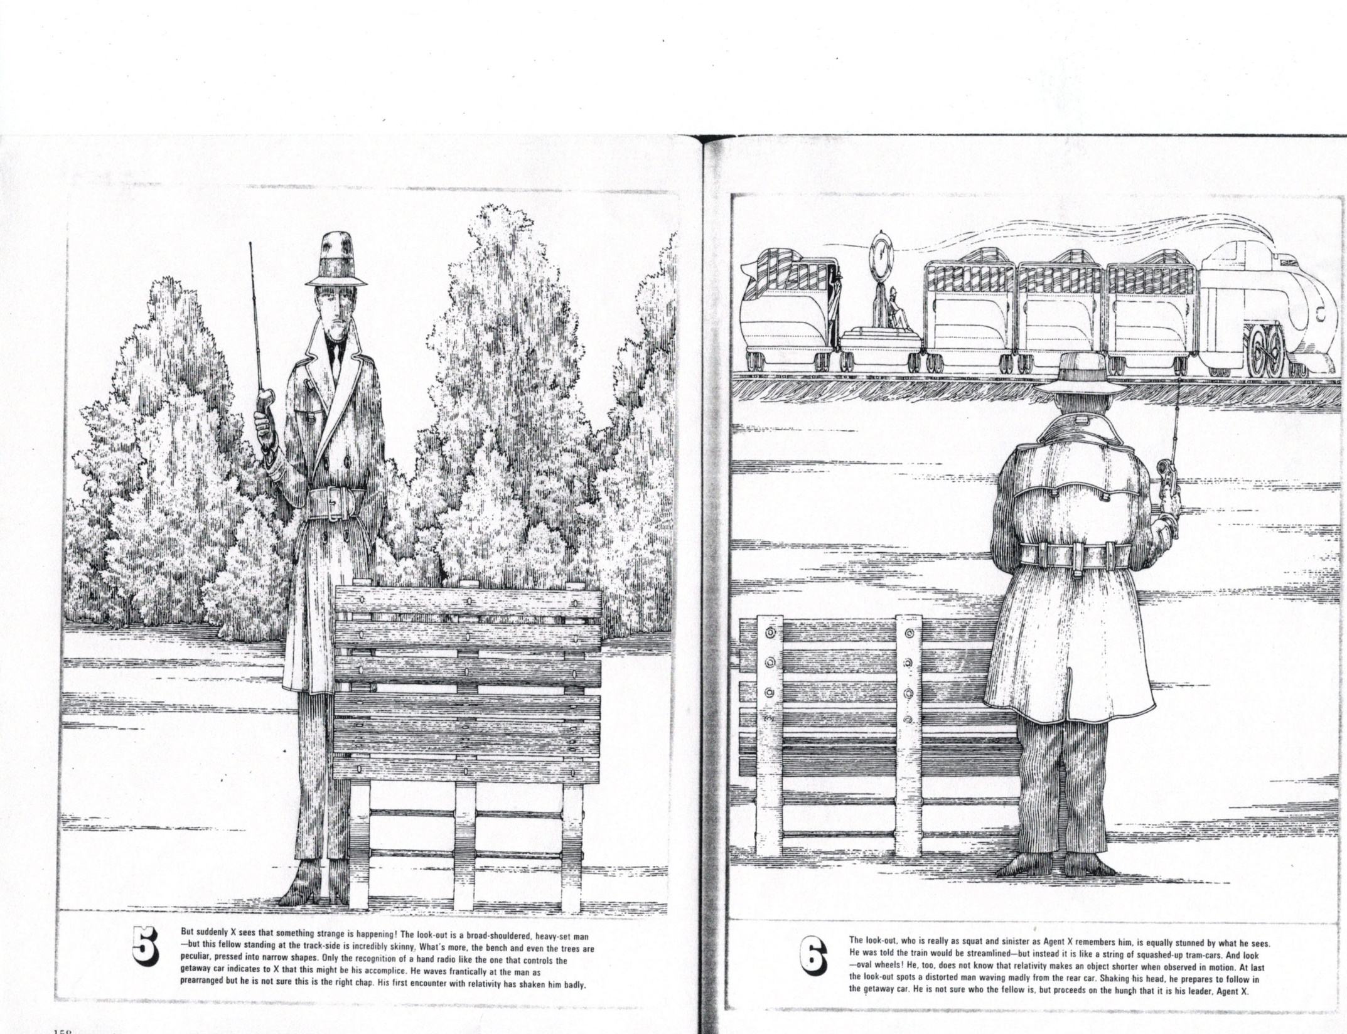

Slide 8
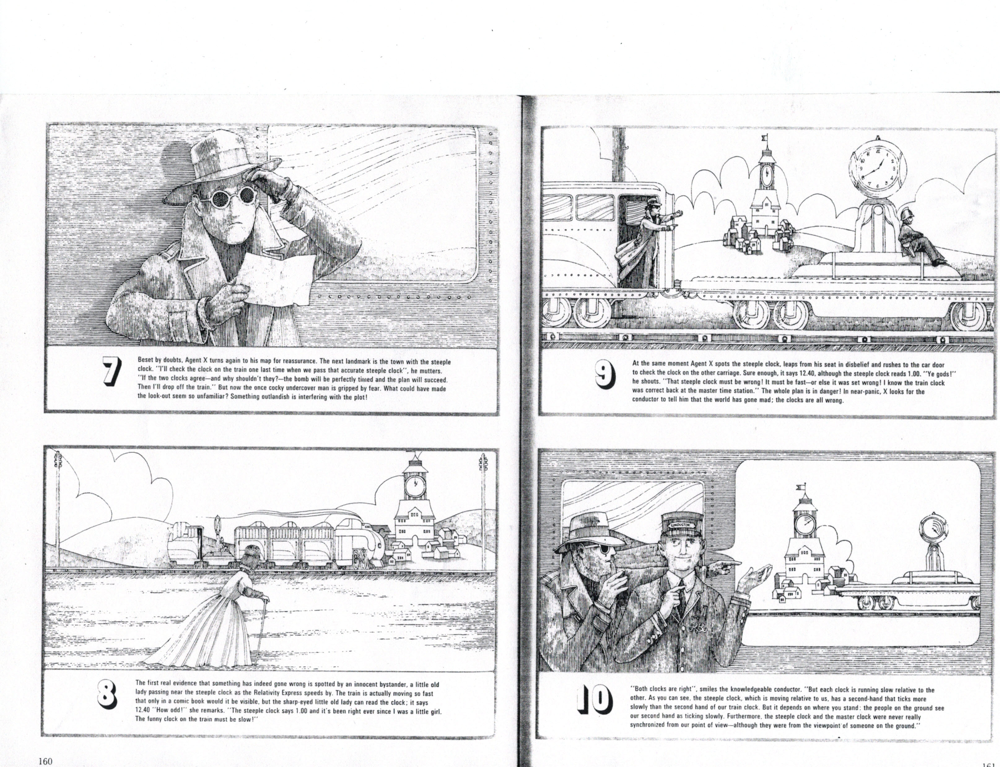

Slide 9
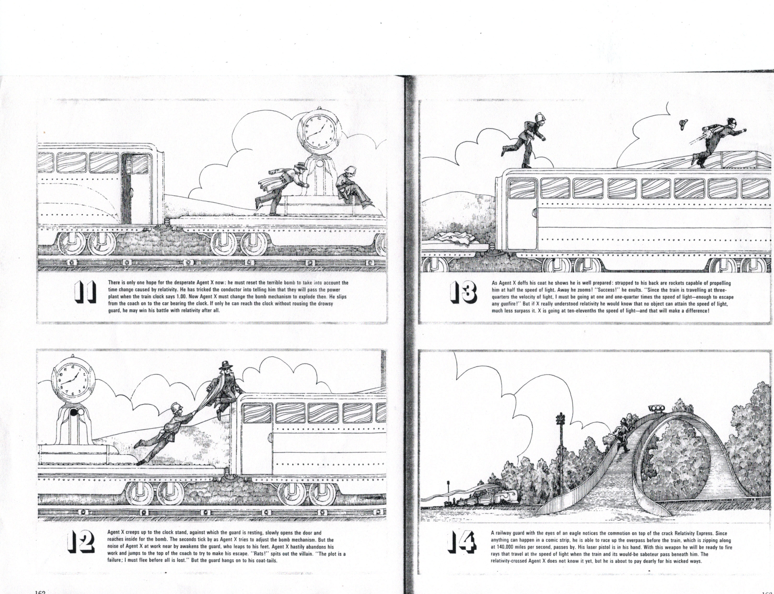

Slide 10
