Slide 1
“The illiterate of the 21st century will not be those
who cannot read and write, but those who cannot
learn, unlearn, and relearn.” – Alvin Toffler

Slide 2
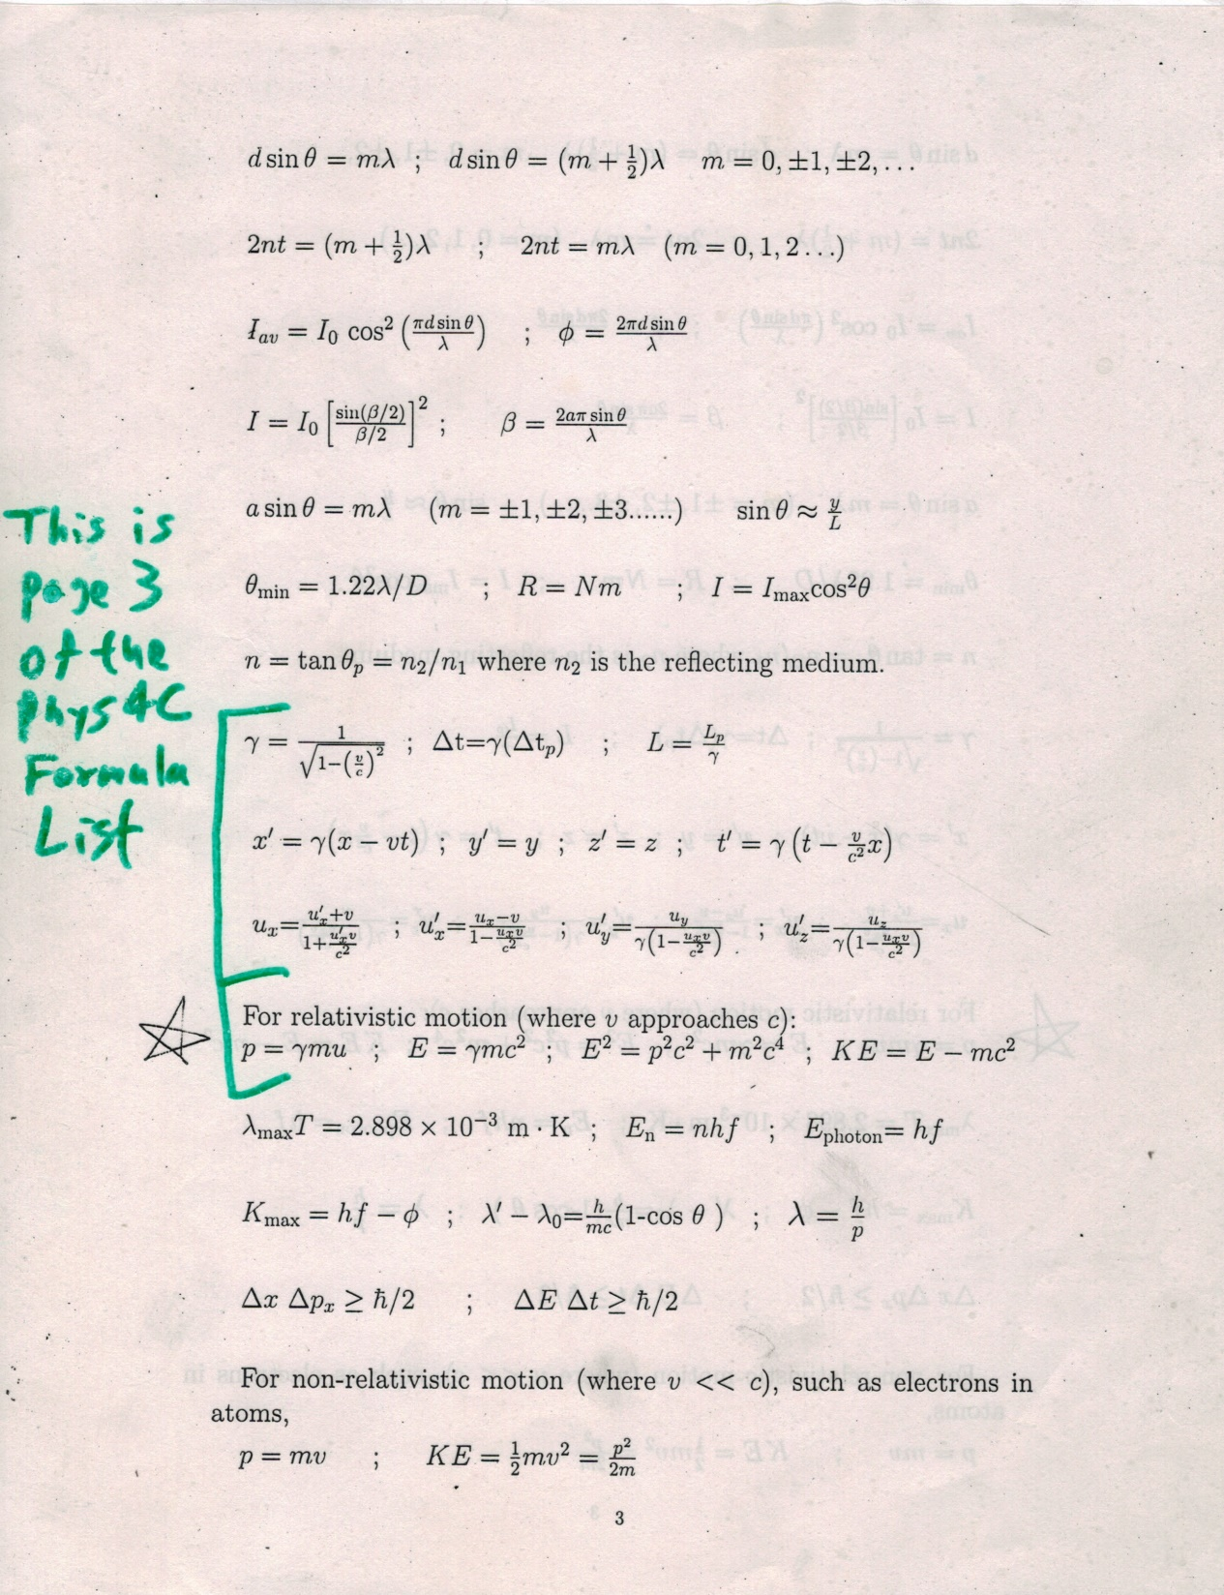

Slide 3
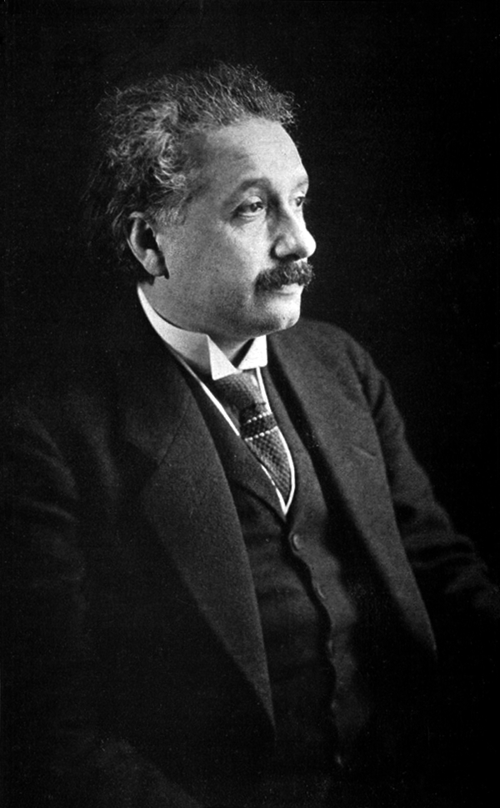
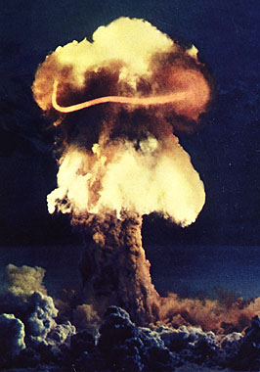
“If only I had known, I should have become a watchmaker.”
– Albert Einstein
“Human history becomes more and more a race between education and catastrophe.”
– H. G. Wells
“If knowledge can create problems, it is not through ignorance that we can solve them.” – Isaac Asimov

Slide 4
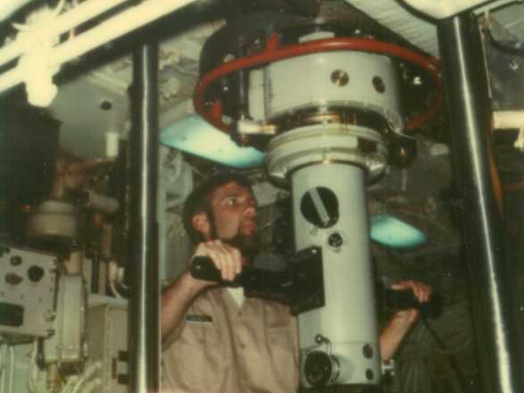

Slide 5
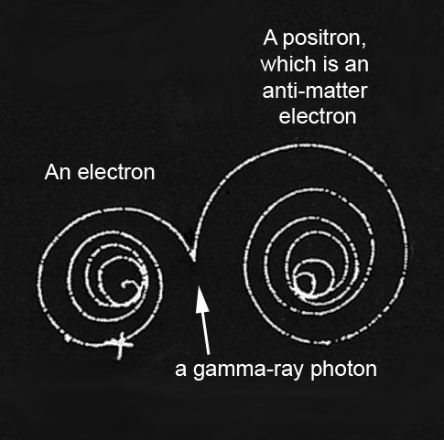
E = m c²
Matter can turn into a huge amount of energy.
Energy can turn into matter, too.
Notes:
5

