Slide 2
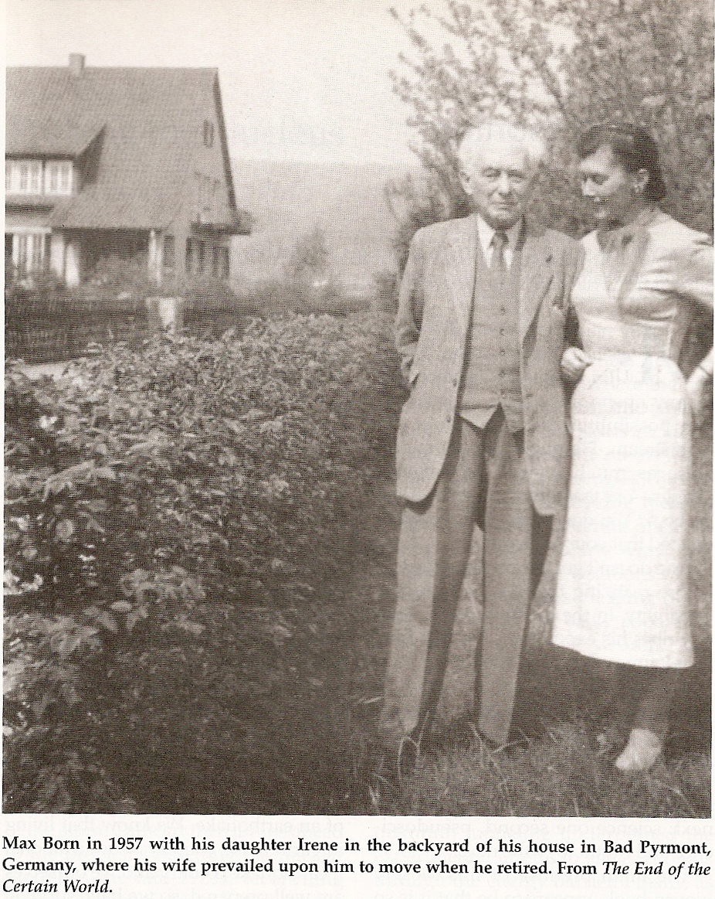
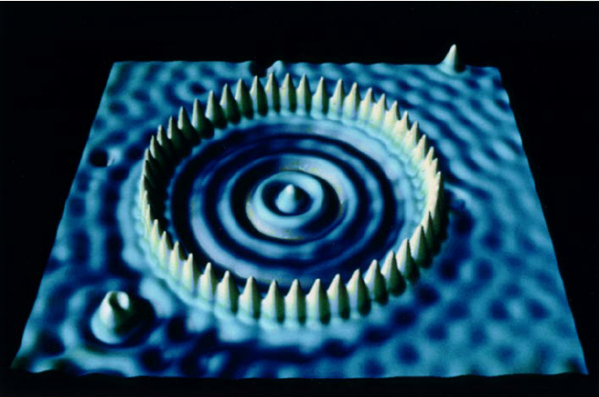
Max Born realized the physical significance of
wave functions (ψ) and probability densities (|ψ|²) for matter waves.

Slide 3
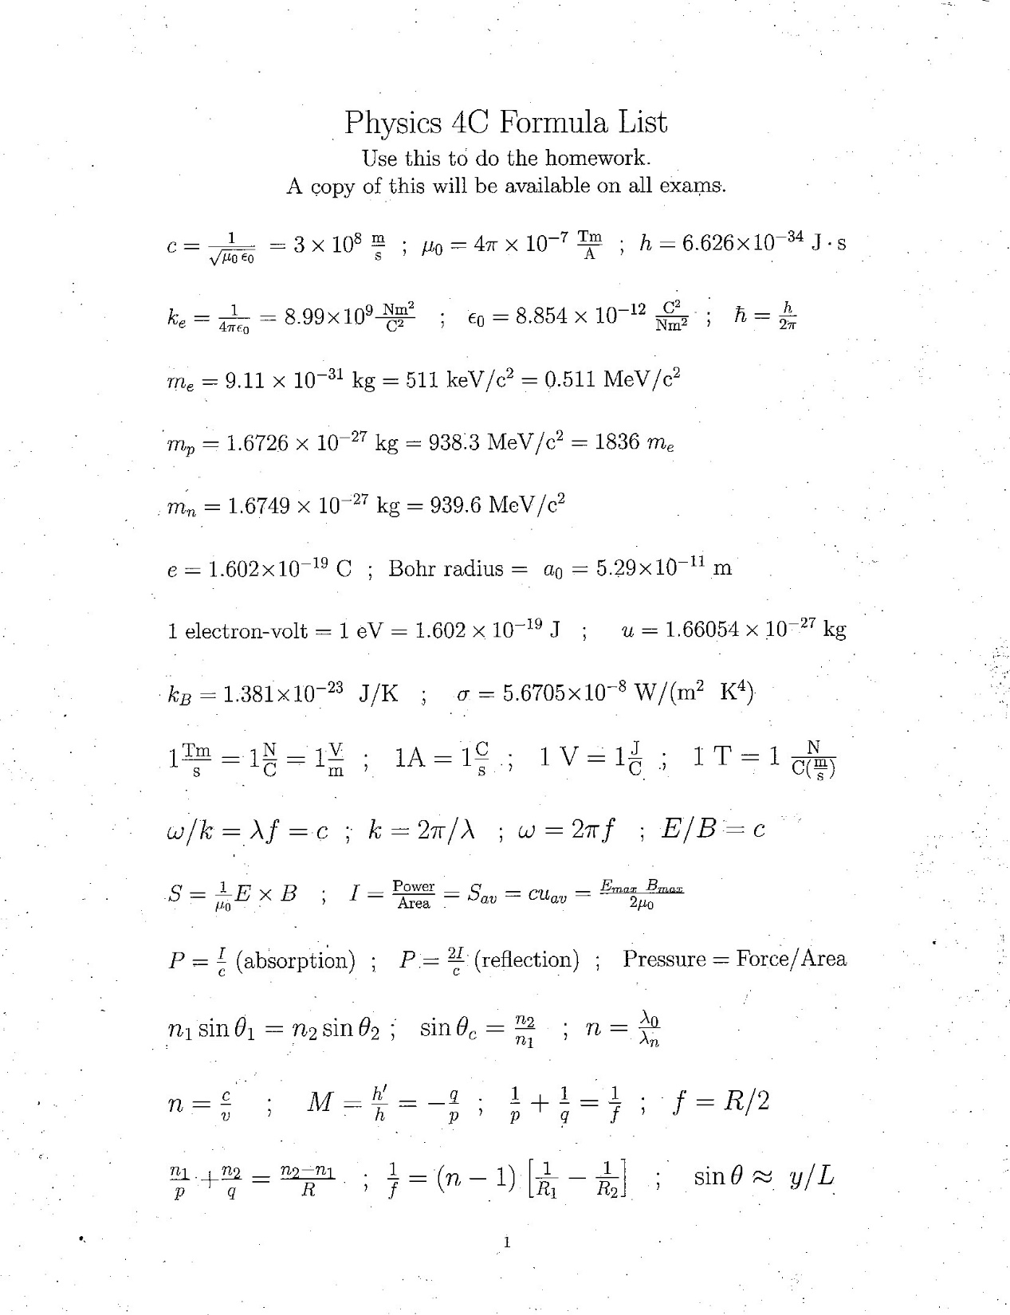
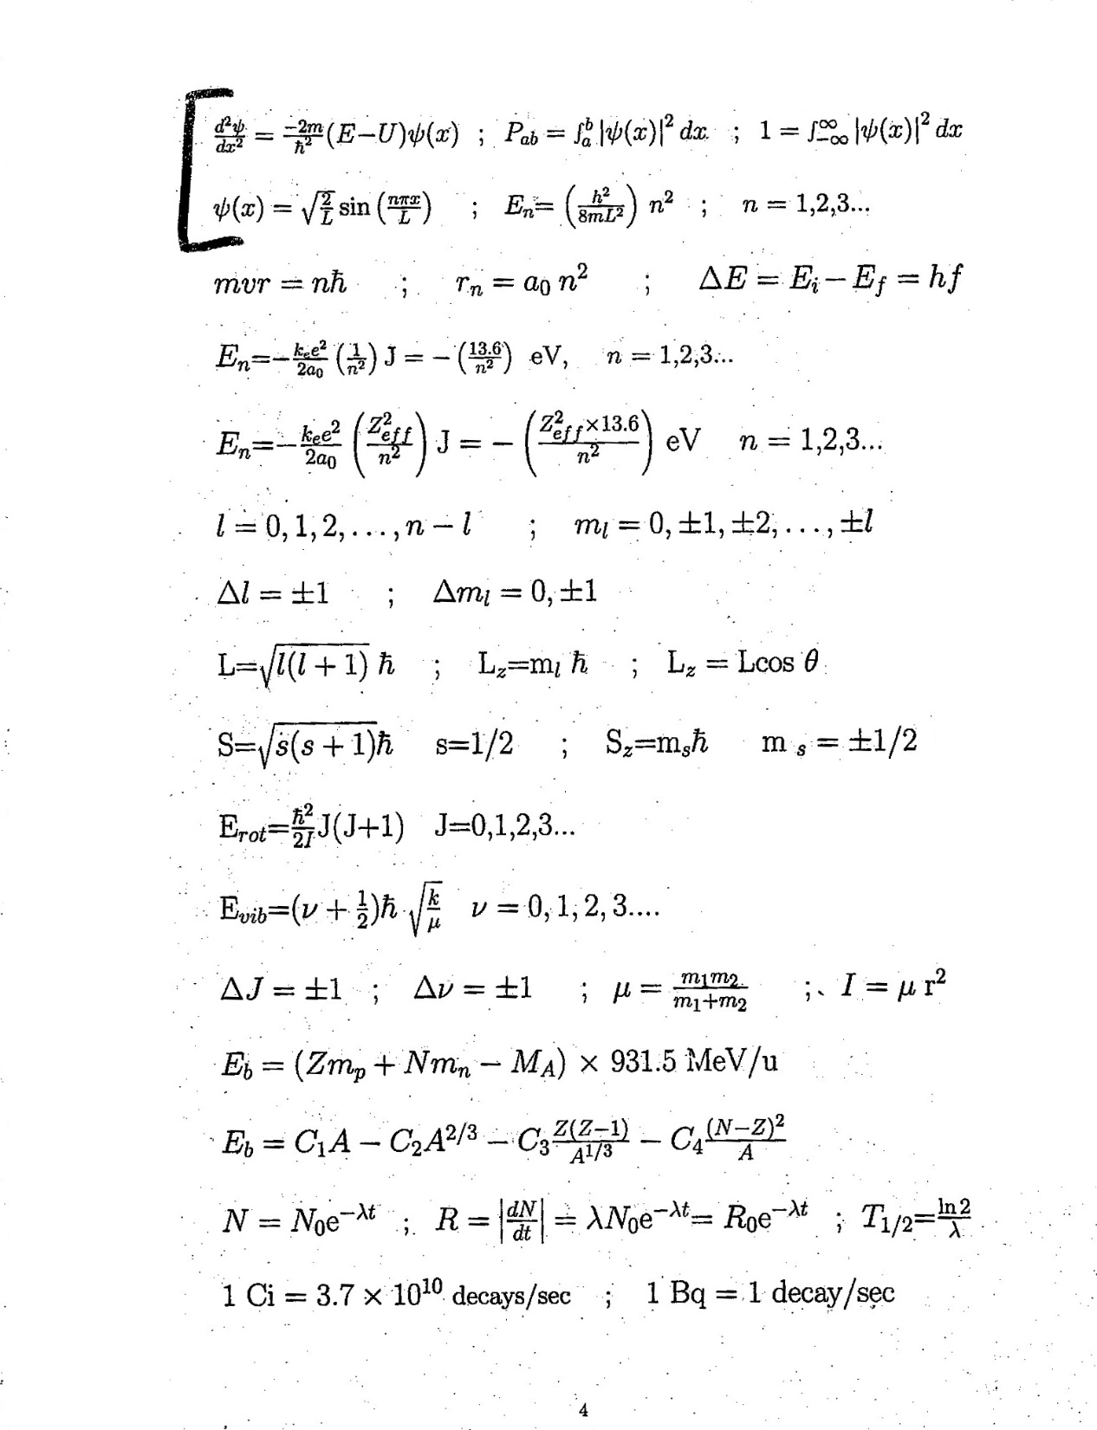
Schrödinger’s
equation and
other equations for
Chapter 40 (QM) are on page 3 of the Phys 4C Formula List

Slide 4
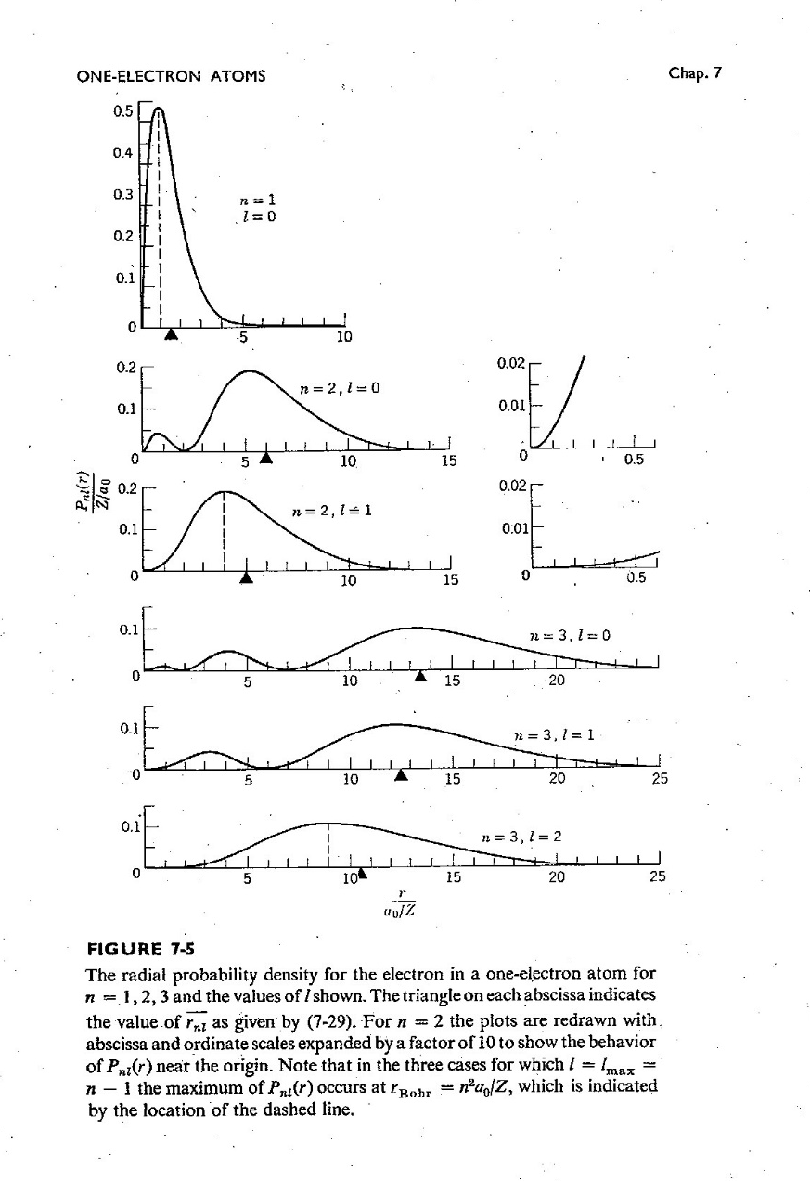
Heisenberg’s Uncertainty Principle
shows that quantum particles
(such as electrons in atoms)
aren’t mathematical points.
They are spread out in space,
because of their wave properties.
One therefore can’t point a finger
and claim that an electron is there.
The best one can do is calculate
the probability density |ψ(x)|²
for where they probably are.
These are plots of probability densities
for the electron in a hydrogen atom.,
for several different energies and values of
angular momentum of the electron.

Slide 5
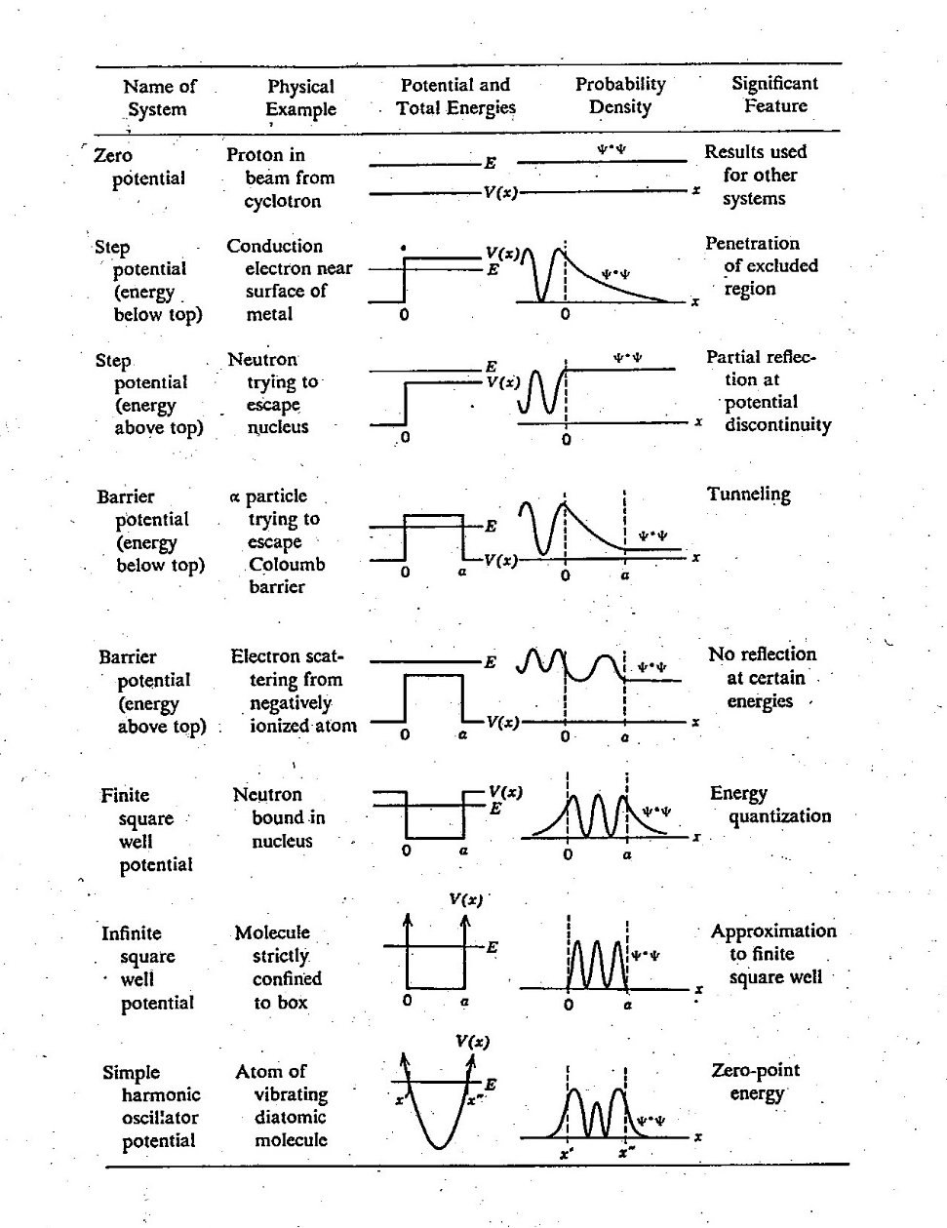
Schrödinger’s equation tells where the matter waves are.
In other words, it gives the wave function ψ
as a function of x (position),
U (the potential energy of any force affecting the particle’s motion),
and E (the total energy of the particle).
An electron in an atom is affected by Coulomb force because it is charged, and so are the protons in the atom’s nucleus.
The wave functions ψ for particles in many potentials have been worked out, and are plotted here.

Slide 6
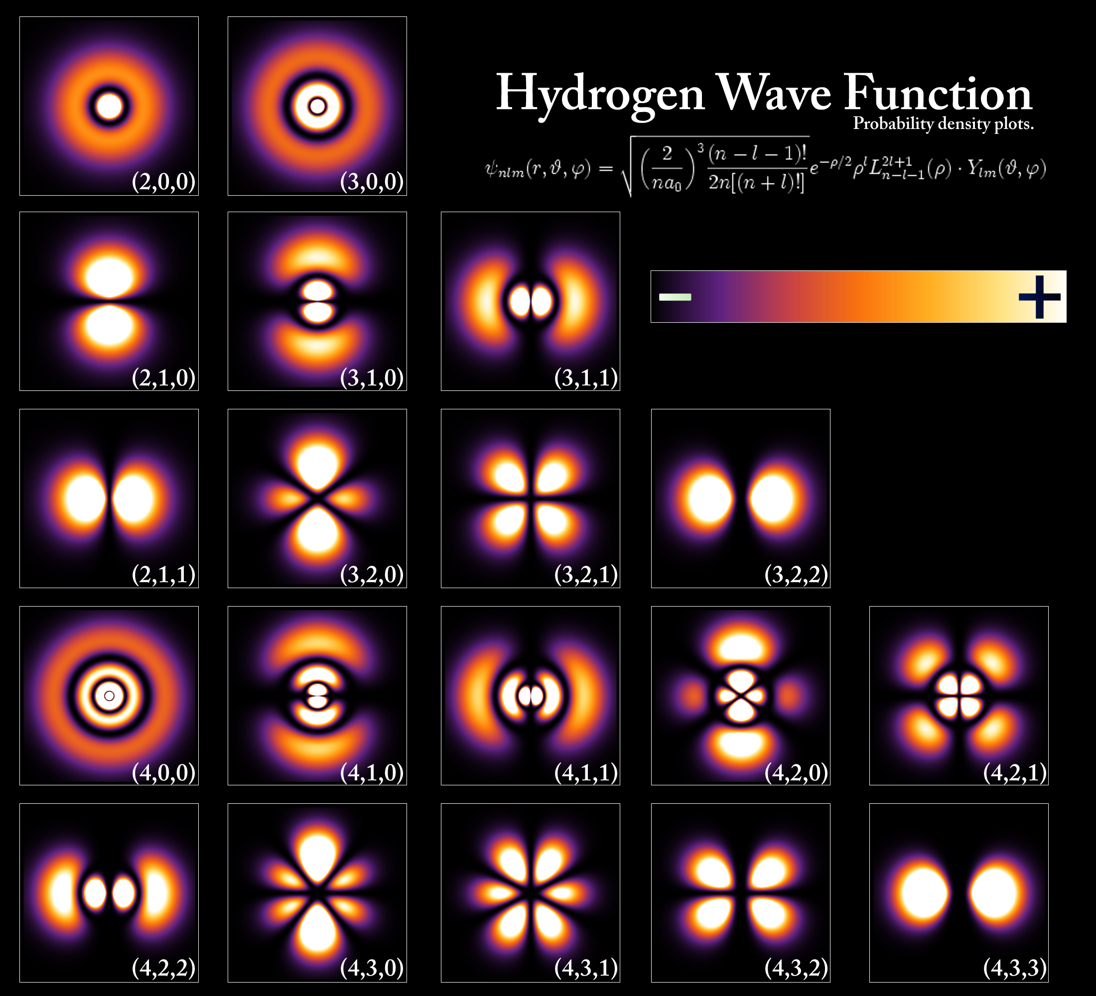
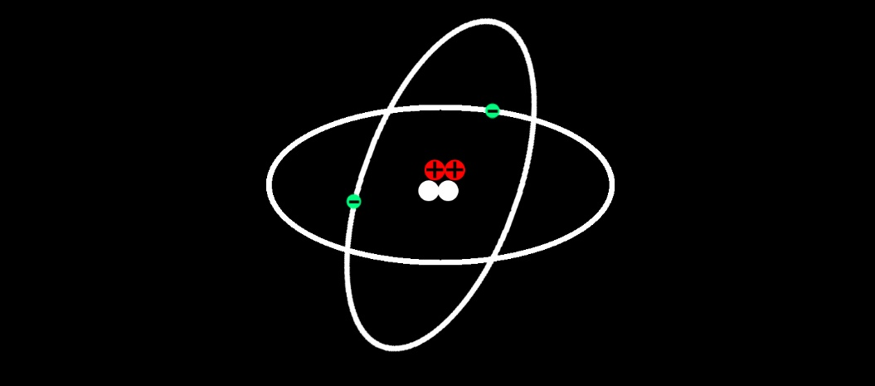
Real atoms therefore don’t look like this:
Real atoms look like those
shown at right,
because of their wave properties.

Slide 7
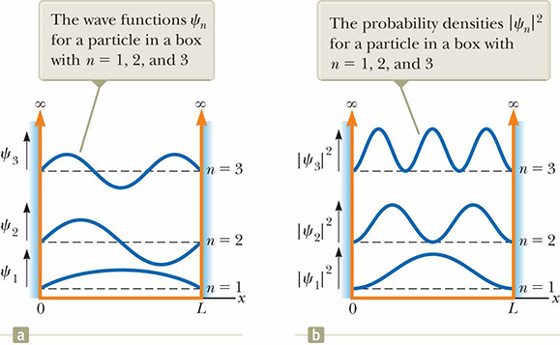
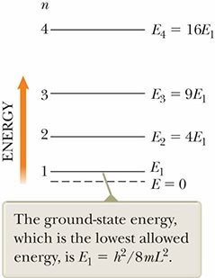
An example of how to use Schrödinger’s equation:
A particle in a box (one-dimensional case),
also called the infinite square well.
Remember: Schrödinger’s equation gives the wave function ψ
as a function of x (position), U (potential energy), and E (total energy).
Values of 0 or 1 in computer memories (“qubits”) work exactly like this.
So do quantum dots in efficient solar panels,
electrons in crystals and metals,
neutrons in nuclei,
and electrons in atoms (approximately).

