Slide 1
Redd Site Selection of the Reintroduced Population of Chinook Salmon (Oncorhynchus Tshawytscha) on the San Joaquin River, California
James Pearson

Slide 2
Overview
Problem
Solution
Hypothesis
Variables
Replication
Type of Experiment
Experimental Error
Statistics
Future Work

Slide 3
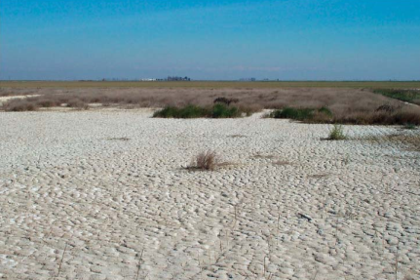
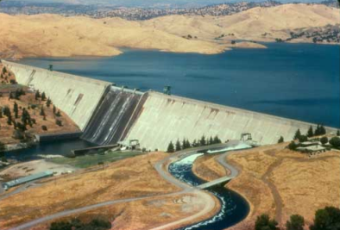
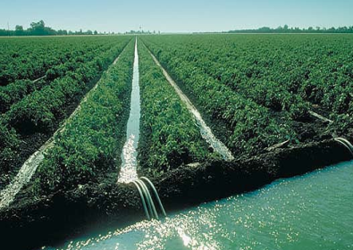
Problem
Dam the rive for
water storage
Barren land needs
water to grow crops
Crops can grow
Ship water via canals
to areas with no water

Slide 4
Problem
60 years this is what the San Joaquin River looked like
Jones, 2014

Slide 5
Problem
That is illegal
Settlement of NRDC et al. v. Kirk Rogers et al. 2006
Created the SJRRP:
San Joaquin River Restoration Program (SJRRP)
Restore the salmon populations and manage the water to minimize adverse affects on water users (farms)
FMP,(2010)
SJRRP Reintroduction Strategy (2011)

Slide 6
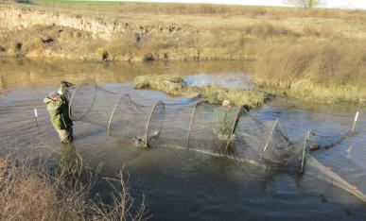
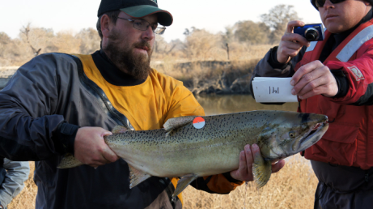
Solution
Bring back the salmon
USBOR
Reintroduce the Chinook salmon to the San Joaquin River
Trapped in Reach 5A
Past the Hills Ferry Barrier
Hauled to Reach 1A
Photos Courtesy of the United States Bureau of Reclamation

Slide 7
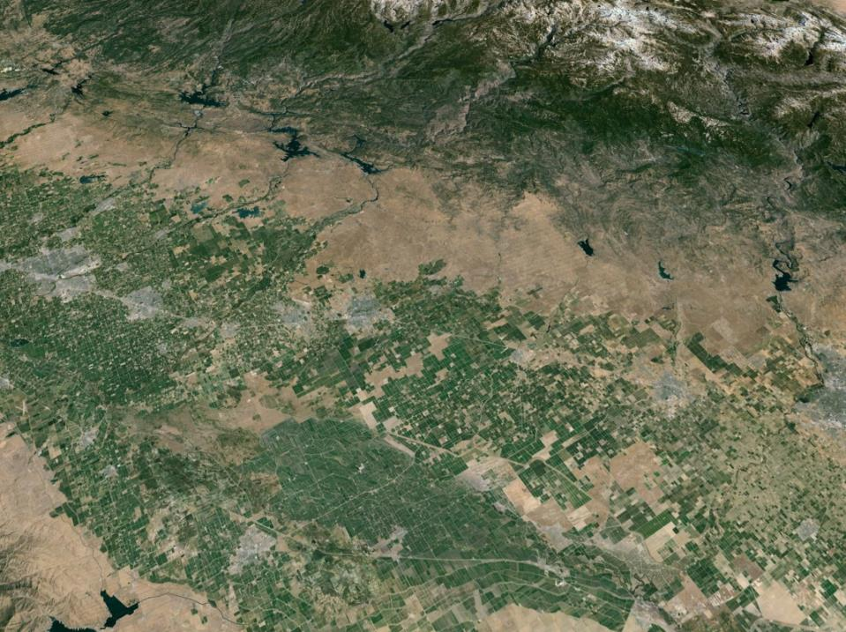
Turlock, Ca
Reach 5A
Fresno, Ca
Reach 1A
83 Miles Via Highway 99

Slide 8
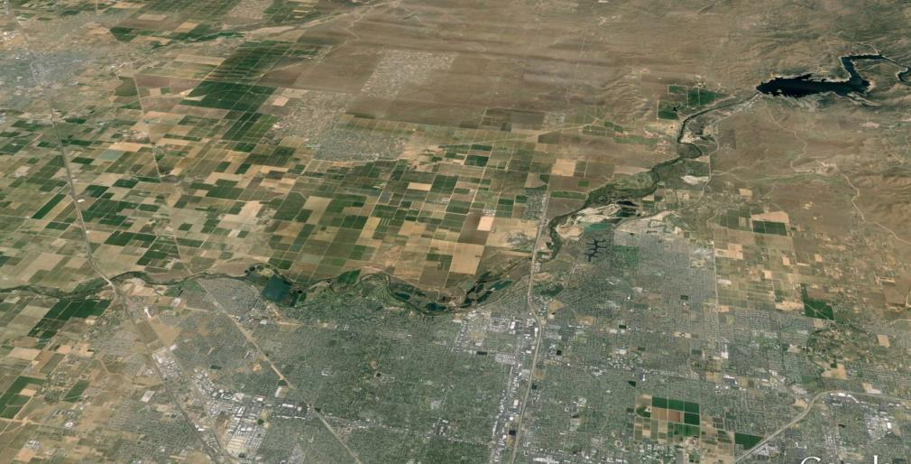
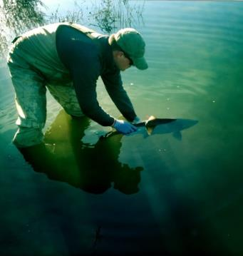
Reach 1A
Lake Millerton
Highway 99

Slide 9
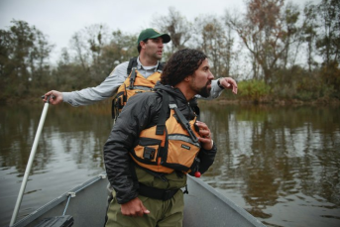
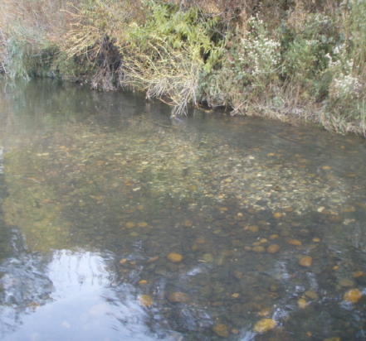
Spawning Survey
Photo Courtesy of the Los Angeles Times (2013)

Slide 10
Lake Millerton
Highway 41
Highway 99
48% (35)
52.0% (38)

Slide 11
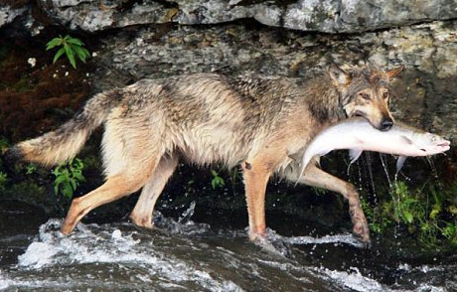
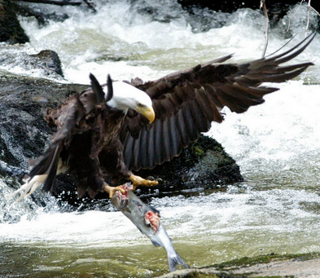
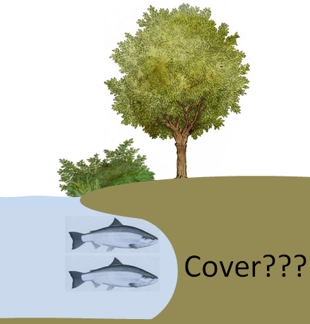
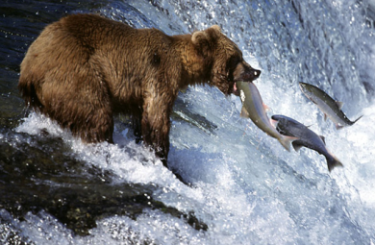
Why do female Chinook salmon select certain areas to create their redds?
http://dolcetours.com/LivingLaDolceVita/2011/07/11/gone-fishing/bear-salmon/
https://carlsafina.wordpress.com/page/4/
http://www.dailymail.co.uk/sciencetech/article-1051637/Fearsome-deer-hunters-No-wolves-dine-dainty-fish-dish.html
Notes:
Many Reasons

Slide 12
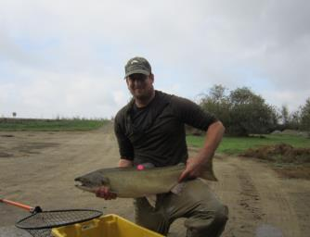
In the Fall of 2014
Trap and Haul
Spawning Surveys
Photo Courtesy of the Los Angeles Times (2013)

Slide 13
Hypothesis
H₀: Redd site selection by Chinook salmon does not vary with regard to available cover
H₁: Redd site selection by Chinook salmon varies systematically with regard to available cover

Slide 14
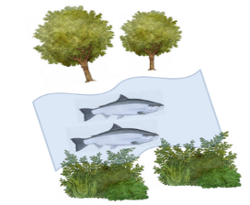
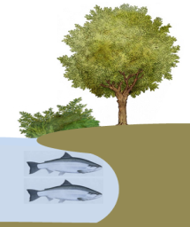
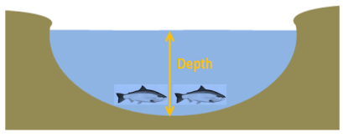
Variables
Individual Redds
Depth (cm)
Distance from Shore (m)
Distance to pool-Riffle Crest (m)
Distance to nearest Overhanging Vegetation (m)
Distance to nearest undercut bank (m)
Activity Area
Deepest point (cm)
Depth of nearest pool (cm)

Slide 15
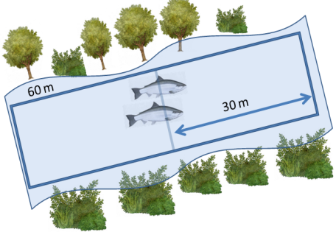
Activity Area
Chinook Salmon arrive at spawning grounds early
30 Meters up and downstream
Total activity area of 60 m
Similar study w/ Coho Salmon
Relative to Chinook Salmon
20 Meters up and downstream
Total activity area of 40 m
Clark & Dunham (2014)

Slide 16
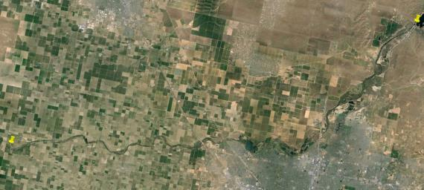
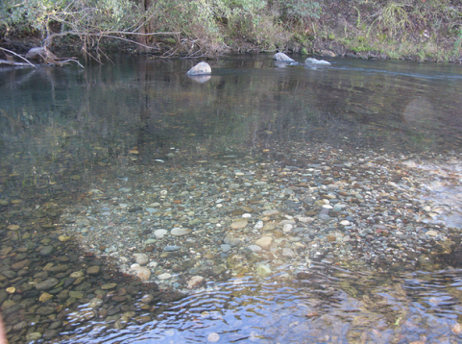
Replication
Experimental Unit:
San Joaquin River
Friant Dam to Skaggs Bridge
Experimental Unit:
San Joaquin River
Reach 1 A/B
Replications:
Psuedoreplications:
Individual
Selected (Redds) = (n)
2014: n = 73 Redds
Control:
Selected vs Non-Selected

Slide 17
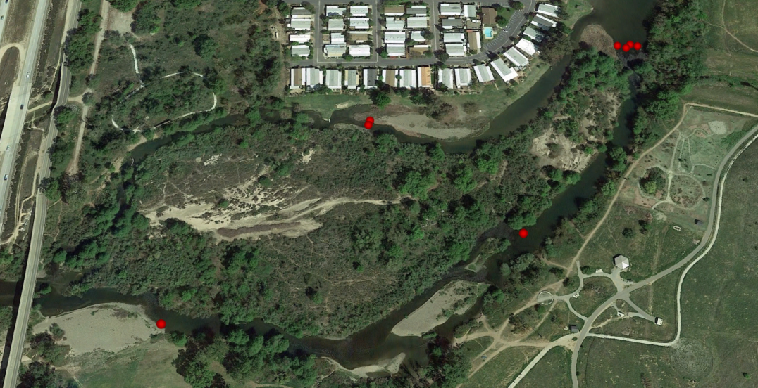
Selected vs. Non-Selected
Notes:
If the selected is similar then the non-selected then there is plenty of spawning habitat
If the selected is dis-similar then non-selected it means there is not enough spawning habitat in the area

Slide 18
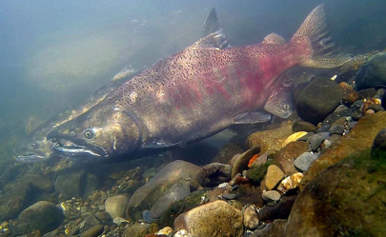
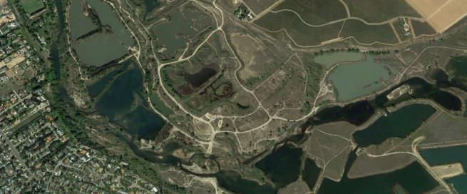
Type of Experiment
Natural Experiment
Spatial
Mensurative Experiment
Generality:
Not DIRECTLY applicable to other rivers
Study Organism
Chinook salmon
Lost, trapped, transported, lacking homing instinct
Study River
San Joaquin River
Highly modified
Mechanism:
Survival
Predator Avoidance
Use of cover
Scale:
Large
24+ Miles
Davis, 2013
Google Earth, 2014
Notes:
Generality:
With respect to generality my project is not very applicable to other rivers. The reason for this is that the Chinook slamon being studied in the San Joaquin River are so different than any other river. All these adults are lost, transported, and lacking any homing instinct once they are placed in to reach 1A of the San Joaquin River.
Mechanism: a level of reductionism that provides a causal explanation of the fundamental relationships among a set of variables
mechanism, scale, generality
Scale
FROM HW 4 STEVE
Overall my experiment is very realistic or ‘realism’ because it will be based on observations seen in the San Joaquin River under the ‘most’ naturally possible conditions (I say ‘most’ because this is the San Joaquin River).

Slide 19
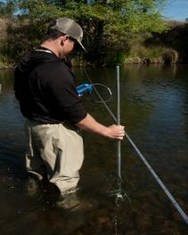
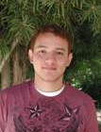
Experimental Error
3.79 meters
Got it
Error
Measurements Errors
Meter Tapes, LRF, Meter Sticks
Annotation Errors
Potential Pitfalls
Drop in water Levels
Contingency:
Sample b/c water drops at all sites
Relying on USFWS data
Wayward GPS points
Contingency:
None
Cost
Low Cost
Measurements
Volunteer Workers
Distance
3.59 cm

Slide 20
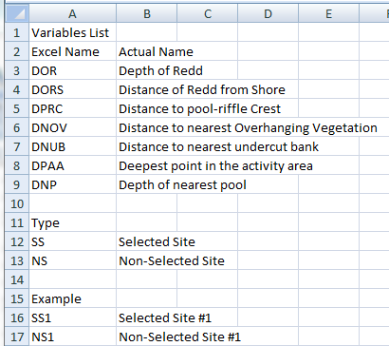
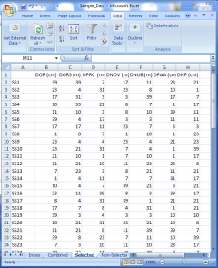
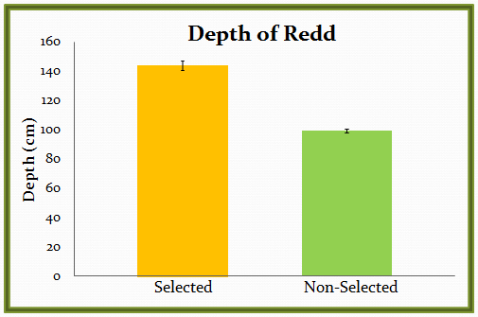
Example Stats

Slide 21
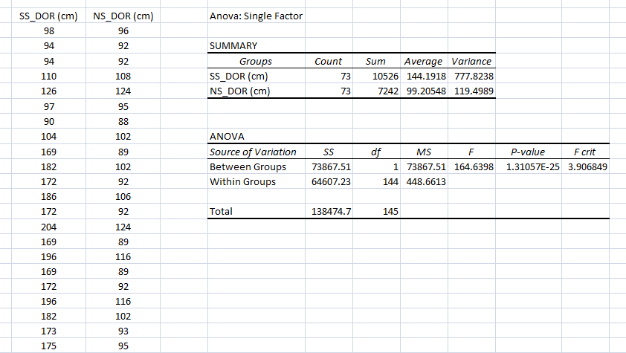
Statistics
Tests
ANOVA
Comparing two means
No: Post hoc Tukey Test (Three or more locations)
Yes: Post hoc Pairiwise T-test (Two: selected and non-selected)
AIC: Akaike Information Criterion
Takes the variables and makes a model
Best Model which incorporates trade-off between the goodness of fit of the model and the complexity of the model

Slide 22
Future Work
Use data and Modeling
Next Grad Student
Determine if the SJR has enough cover
This project helps the SJRRP…..
Aid restoration projects
More Cover?
Adding Cover features
Less Cover?
Don’t waste money/time

Slide 23
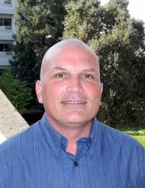
Special Thanks to…..
Dr. Blumenshine
Taylor Spaulding
Kyle Griffiths

Slide 24
Works Cited
"California Climate Station Precipitation Summary." California Nevada River Forecast Center. NOAA, 03 May 2014. Web. 04 May 2014.
Clark, S. M., Dunham, J. B., McEnroe, J. R., & Lightcap, S. W. (2014). Breeding site selection by Coho salmon (Oncorhynchus kisutch) in relation to large wood additions and factors that influence reproductive success. Canadian Journal of Fisheries and Aquatic Sciences, 71(999), 1-10.
Cunningham, Laura (2013). A Wild San Joaquin River at the Site of Today's Friant Dam. Digital image. Blast from the Past. Earth Island Journal, n.d. Web. 18 Nov. 2014.
Davis, Ken W 2013. "Putah Creek Chinook Salmon." Yolo County News. Davis Enterprise, 2 Dec. 2013. Web. 18 Nov. 2014.
DeBare, Llana. "Golden Gate Birder." Restoring the San Joaquin River. Golden Gate Audubon Society, 30 Sept. 2012. Web. 04 May 2014.
Fickenscher, Pete. The Friant Dam. 2006. NOAA Photo Library, Friant.
"Fresno California." Google Map/Earth. N.p.: n.p., 2014. N. pag. Print.
Fisheries Management Plan: A Framework for Adaptive Management in the San Joaquin River Restoration Program (2010). Draft Program Environmental Impact Statement/Report.Friant Dam. (2009). Bureau of Reclamation Homepage. Retrieved July 8, 2014, from http://www.usbr.gov/projects/PrintFacilityAttributes.jsp?fac_Name=Friant%20Dam
Grossi, Mark. "For San Joaquin River Revival, Drought Becomes Way of Life." Outdoors. FresnoBee.com, 5 Apr. 2014. Web. 04 May 2014.
Jones, Alison. San Joaquin River. 2014. Nowater-nolife.org, San Joaquin.
Sullivan, Justin. Jerry Brown. 2014. Getty Images, Sacramento.
Suzuki, Lea. Snow Pack. 2014. The Chronicle, Sacramento.
Visser, Nick. "California Drought Worsens After State's Warmest Winter On Record." The Huffington Post. TheHuffingtonPost.com, 18 Mar. 2014. Web. 04 May 2014.
Walker, John. Don Portz, USBOR. 2014. FresnoBee.com, Fresno.
Weber, M. San Joaquin Riverbed. 2012. Fresno.

