Slide 1
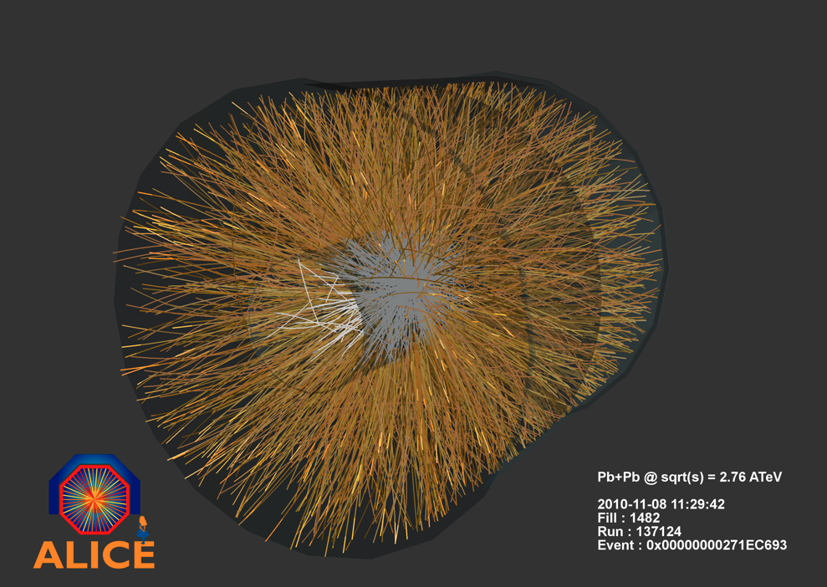
A Large ION Collider Experiment
Jennifer Klay
Cal Poly San Luis Obispo

Slide 2
Goal of ALICE: To Explore the Phase Diagram of Nuclear Matter
Early Universe
Quark Gluon Plasma
Temperature
Neutron stars
Normal Nuclei
Matter Density

Slide 3
Brief History of the Universe

Slide 4
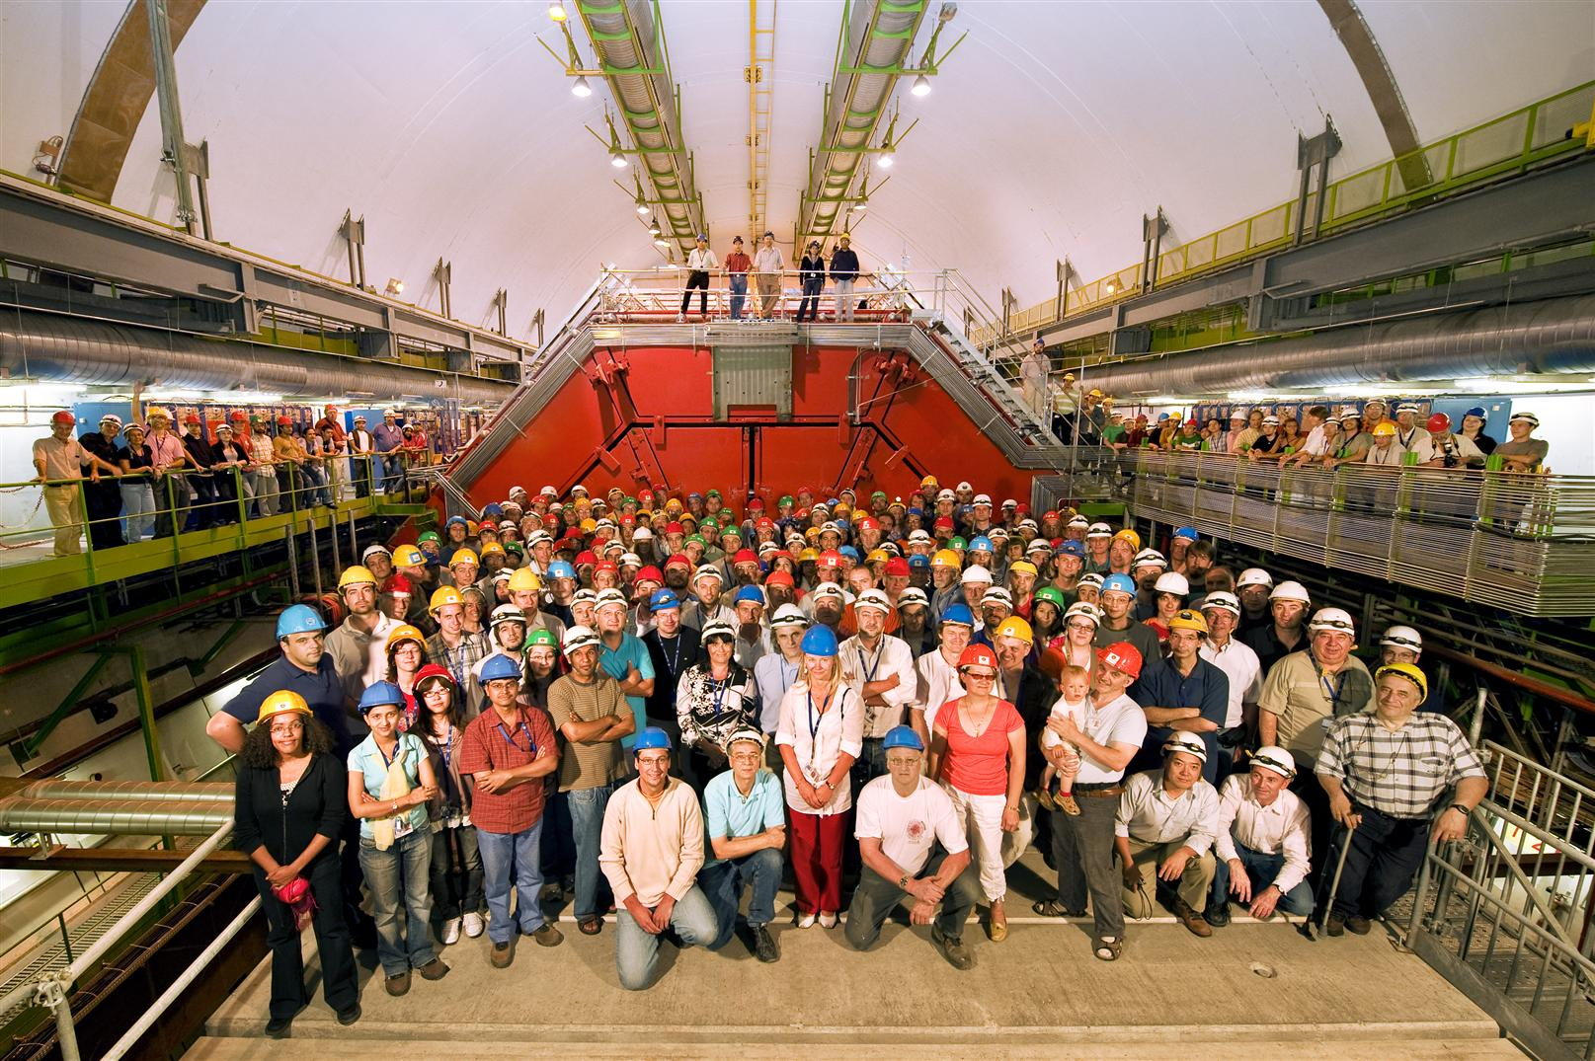
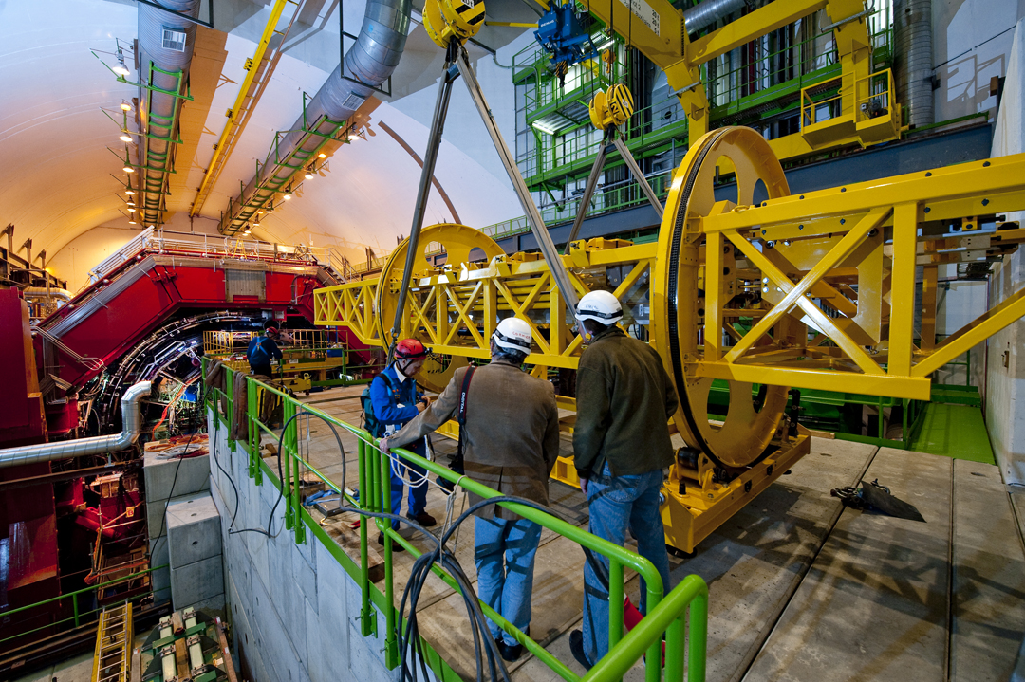
ALICE Collaboration
More than 1,000 physicists, engineers and technicians
Including 200 students
From 111 institutions
In 31 countries
Africa, Americas, Asia, Europe
US in ALICE:
53 physicists, engineers and students
11 universities and laboratories
1 supercomputer center
8 states
© CERN

Slide 5
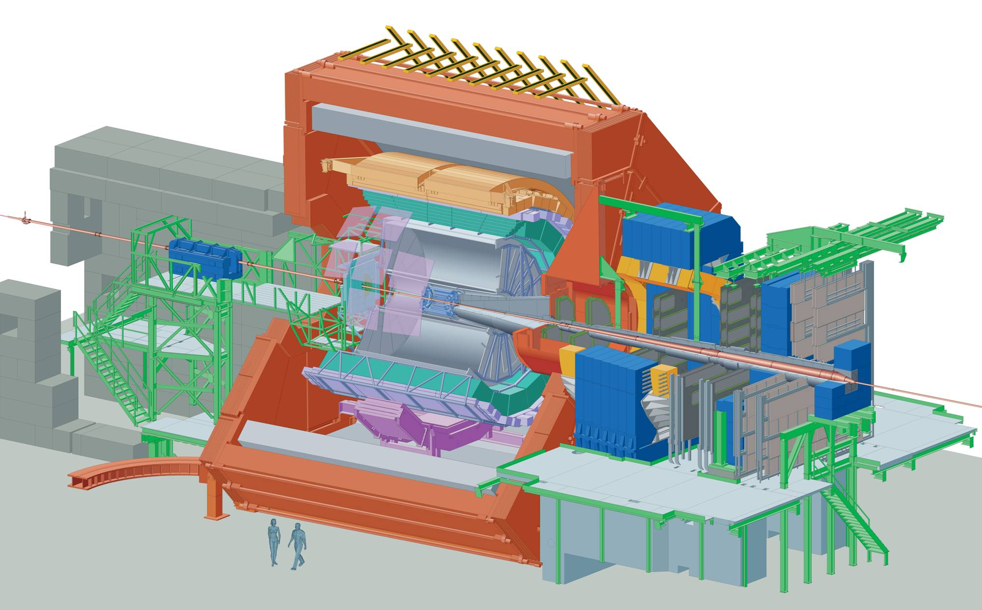
A Large Ion Collider Experiment
Size: 16 x 26 meters
Weight: 10,000 tons
18 different technologies

Slide 6
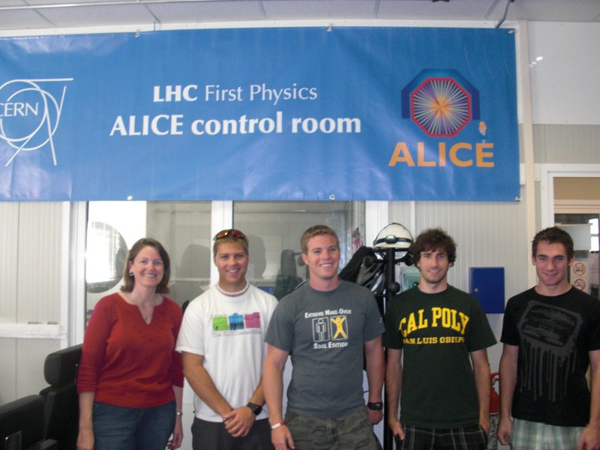
Cal Poly in ALICE
http://nuclear.calpoly.edu/~alice
NSF funded since 2007
ALICE M&O ~$10k/year
PI summer salary
1000 student assistant hours
Travel to CERN/conferences
Computers
16 Cal Poly student participants to date (~3/year)
7 Senior projects
NIM A article with Cal Poly student authors
ALICE Electromagnetic Calorimeter
5 presentations at Cal Poly CoSaM research conference
2 posters at APS-DNP CEU
Physics interests:
Heavy quark energy loss in quark gluon plasma
Comparing properties of electron-tagged jets in p+p and Pb+Pb
Exotica
CHAMPS/Higgs detection with ALICE

Slide 7
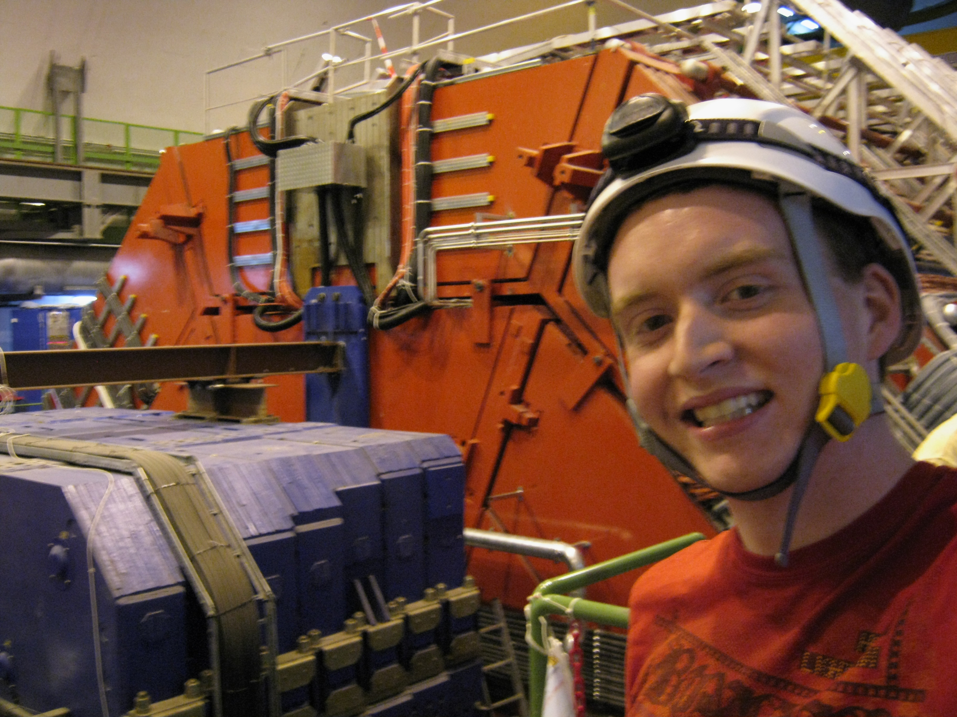
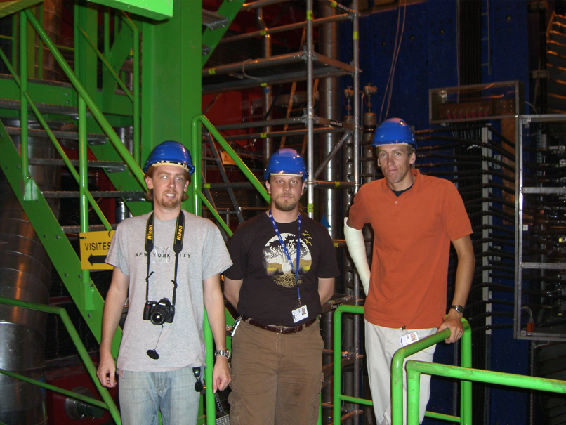
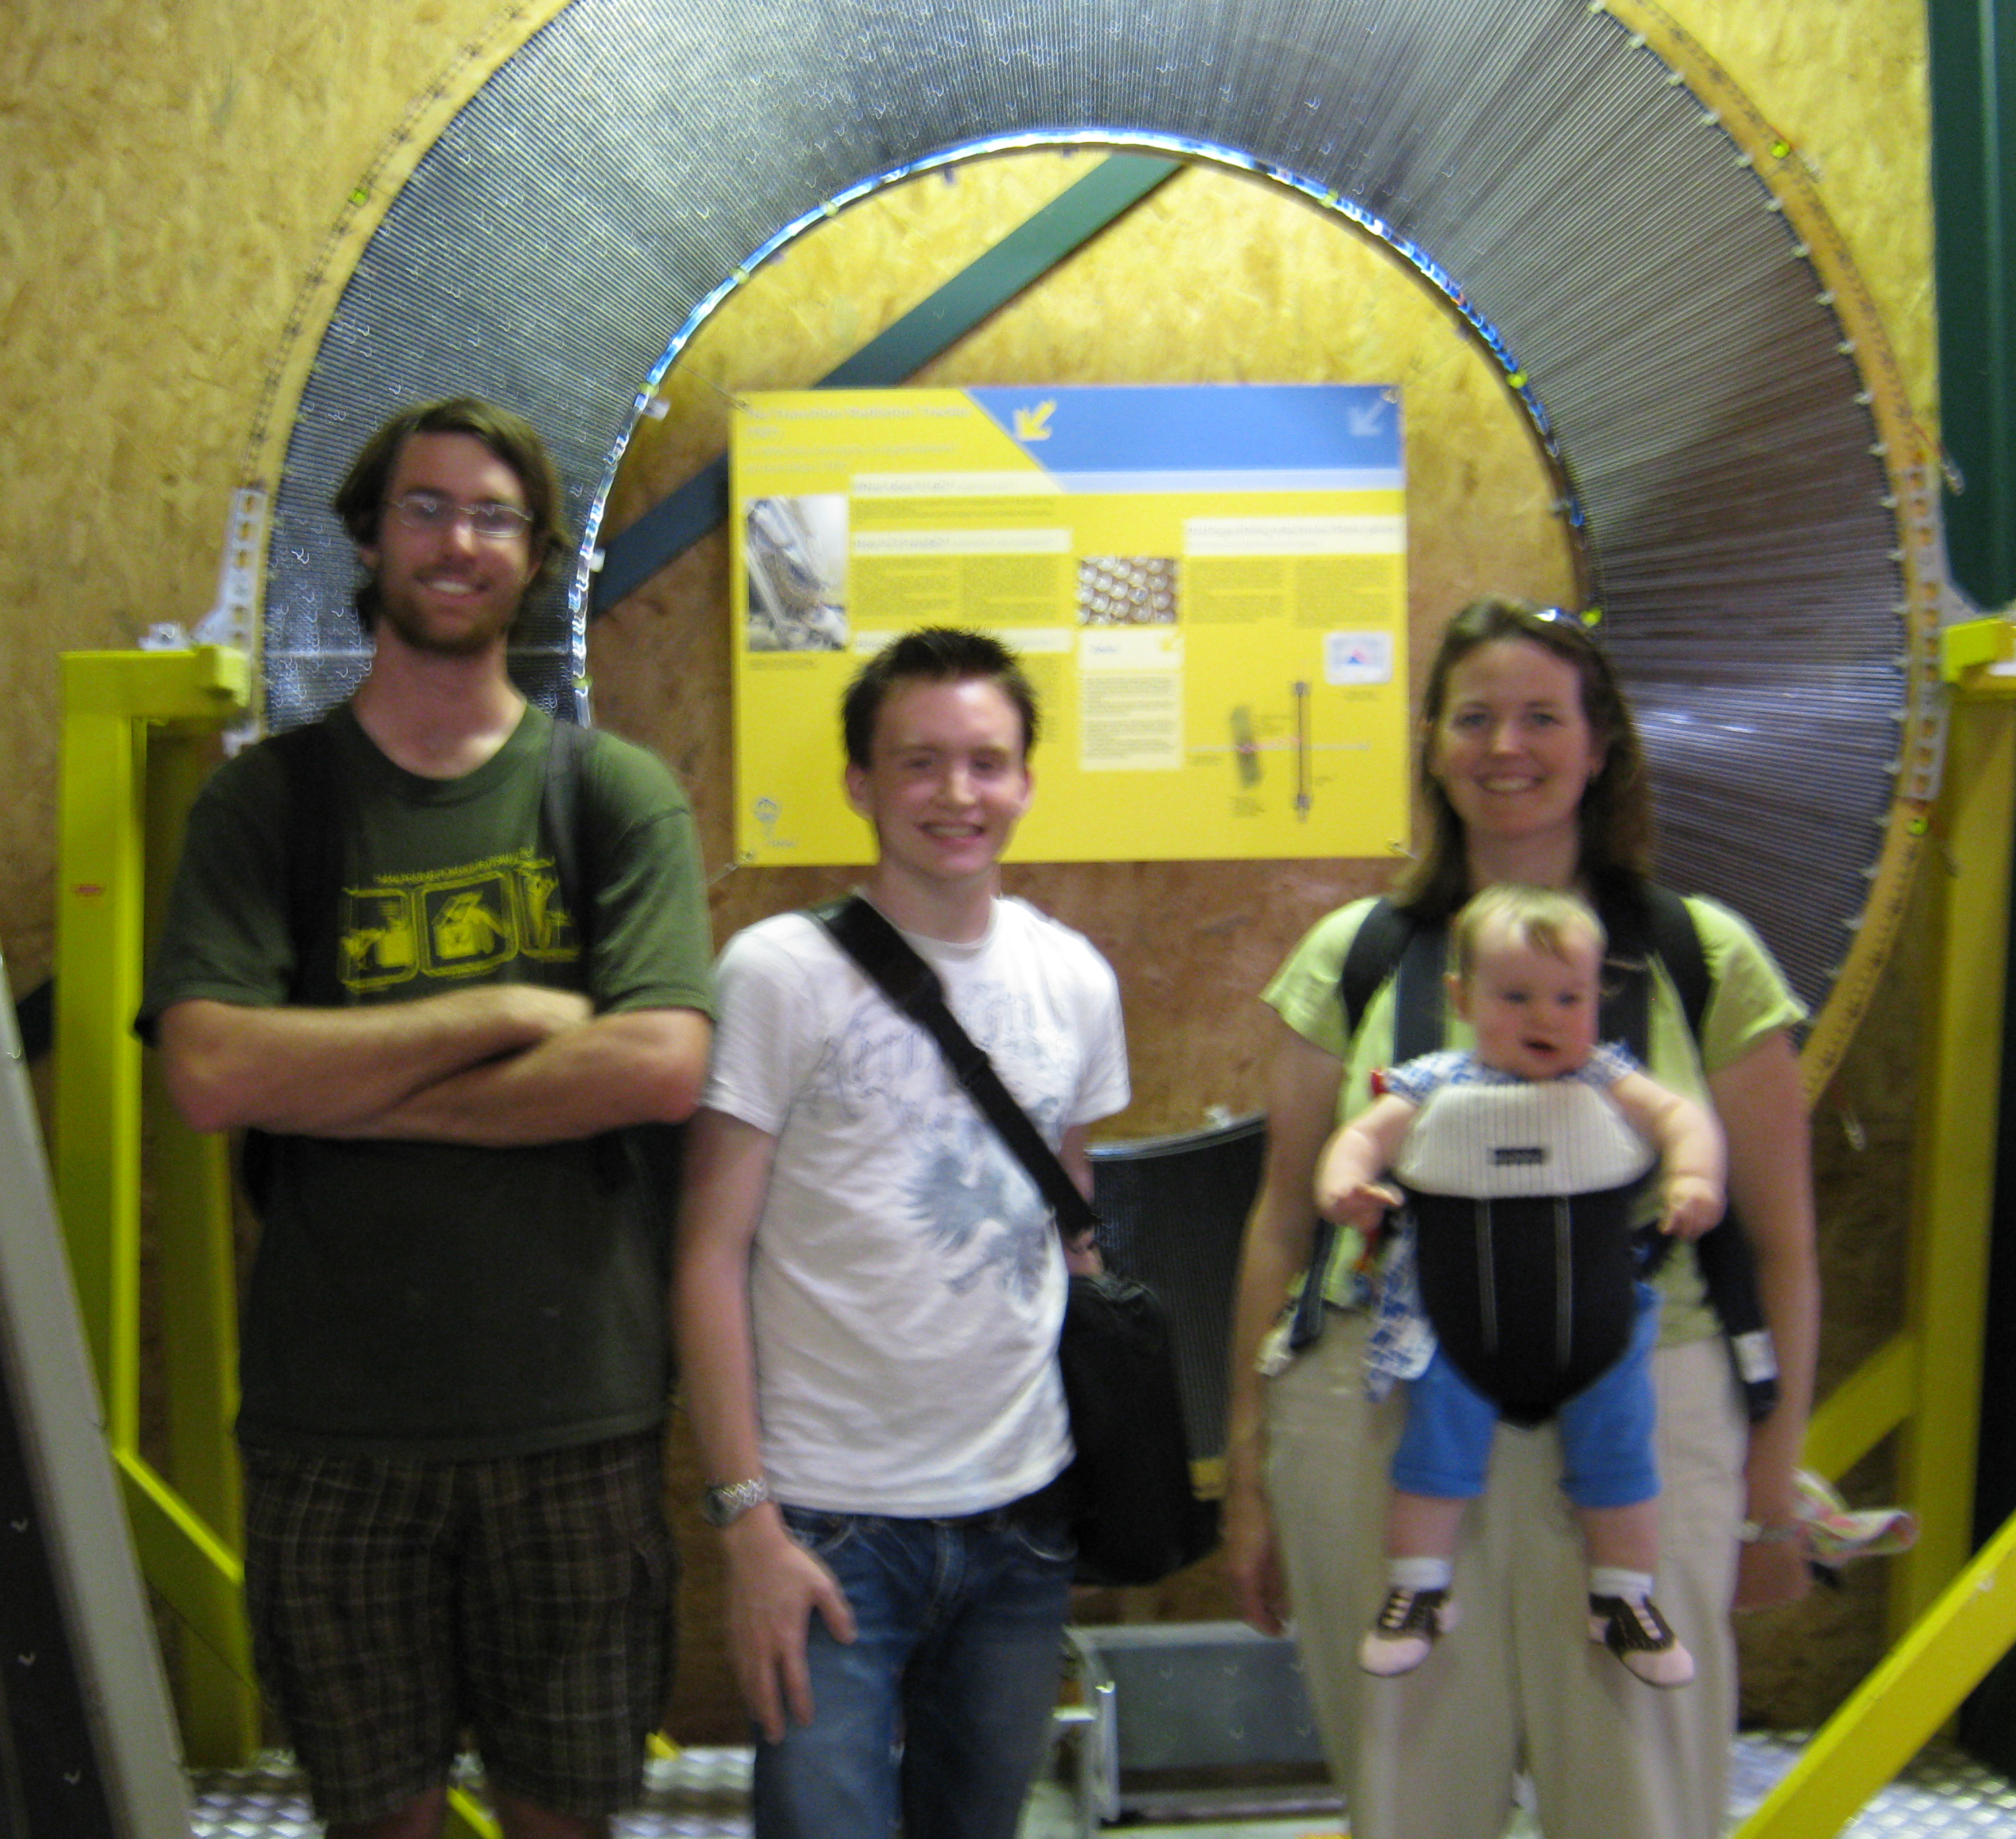
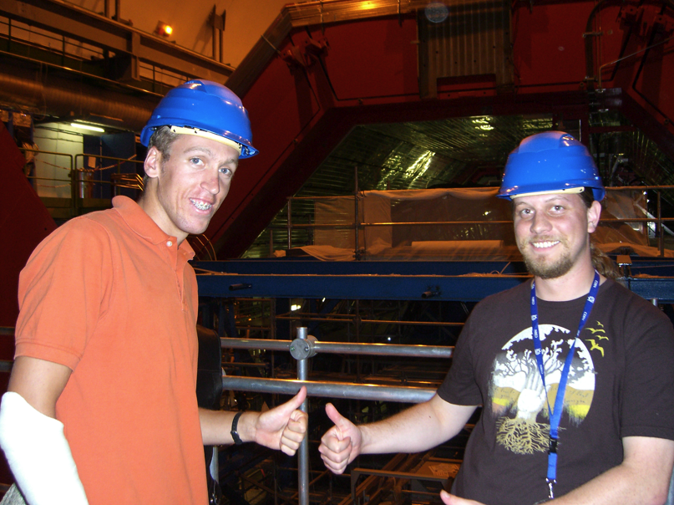
Cal Poly students at ALICE
2007-2008
Content

Slide 8
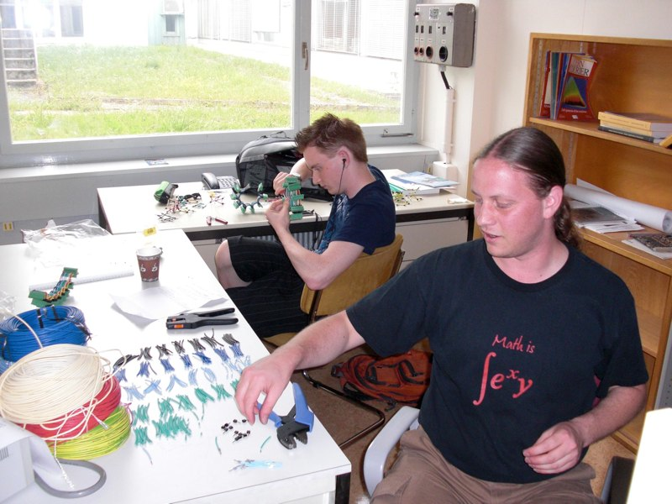
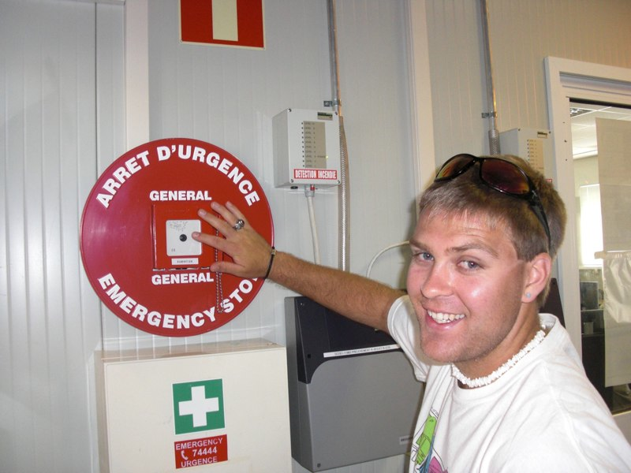
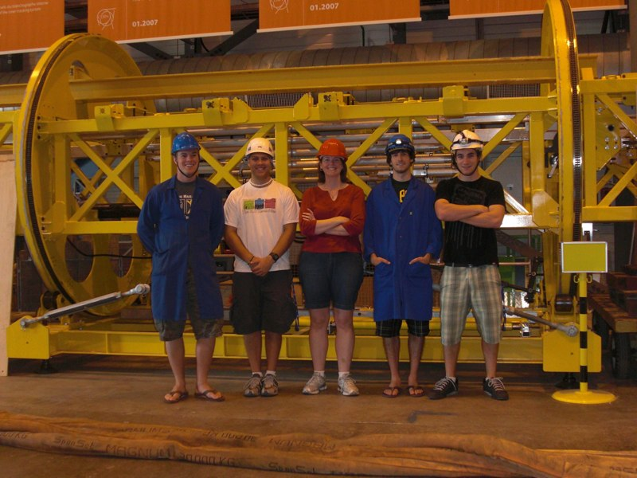
2009-2010
Content

Slide 9
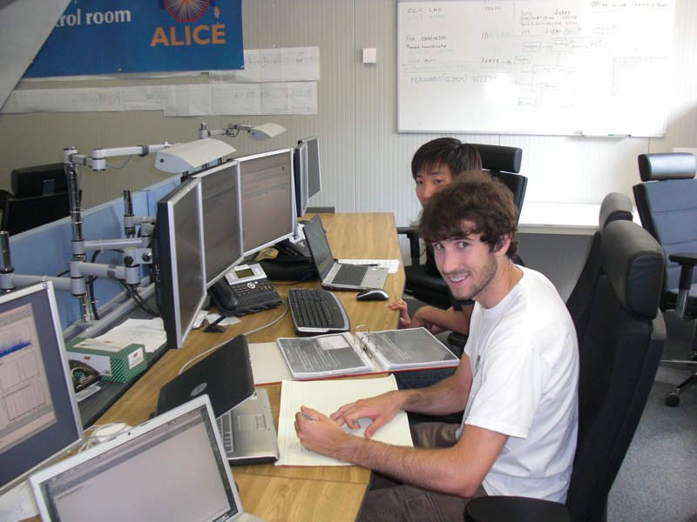
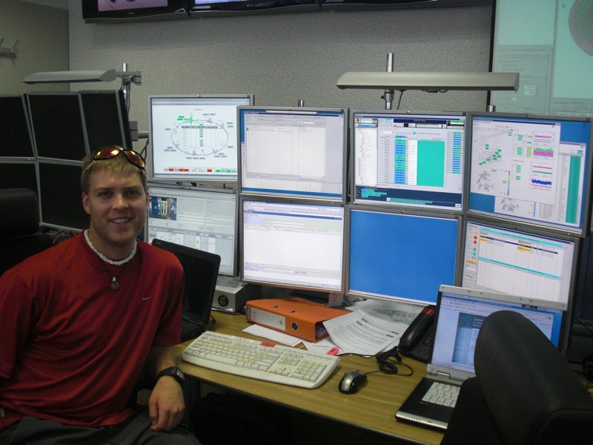
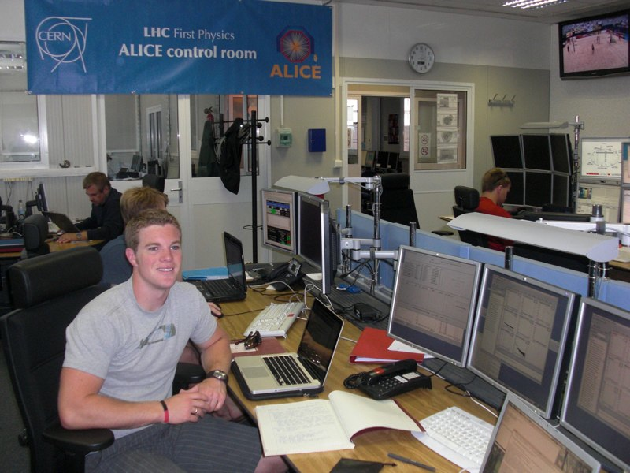
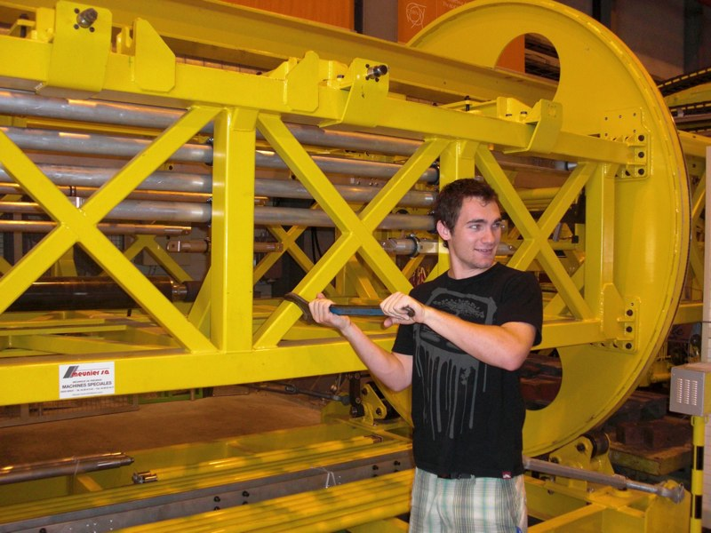
2010

Slide 10
Challenges…
(that consortium funding could help alleviate)
Students’ lack of computing skills
Programming
Unix/linux familiarity
Finding time to supervise students
Heavy teaching load (generally)
Low WTU credit for senior projects
No release time for student research during year
Bringing student analysis to publication stage
Students are short-timers
Analysis and internal ALICE vetting are long processes

