Slide 1
CSU High Energy Physics Consortium Overview
Why a CSU high energy physics (hep) consortium? – To pool resources and talent of faculty/students across the CSU to have an impact on large experiments on the LHC.
The challenge – To compete with R1s which have more resources lower teaching load.
The answer – By combining resources we hope to use the size of the entire CSU system to compensate for this disadvantage

Slide 2
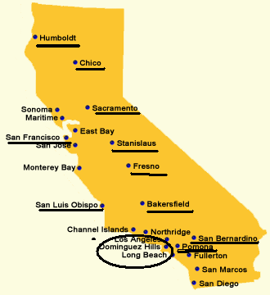
Current configuration of the CSU HEP consortium
Currently there are 13 campuses in the consortium.
Each campus has a liaison: (i) a point of contact for students looking for summer research; (ii) arranges colloquium talks.
The goal – more concrete consortium; more defined and expanded roles for liaison faculty and more benefits (release time, joint grants, etc).

Slide 3
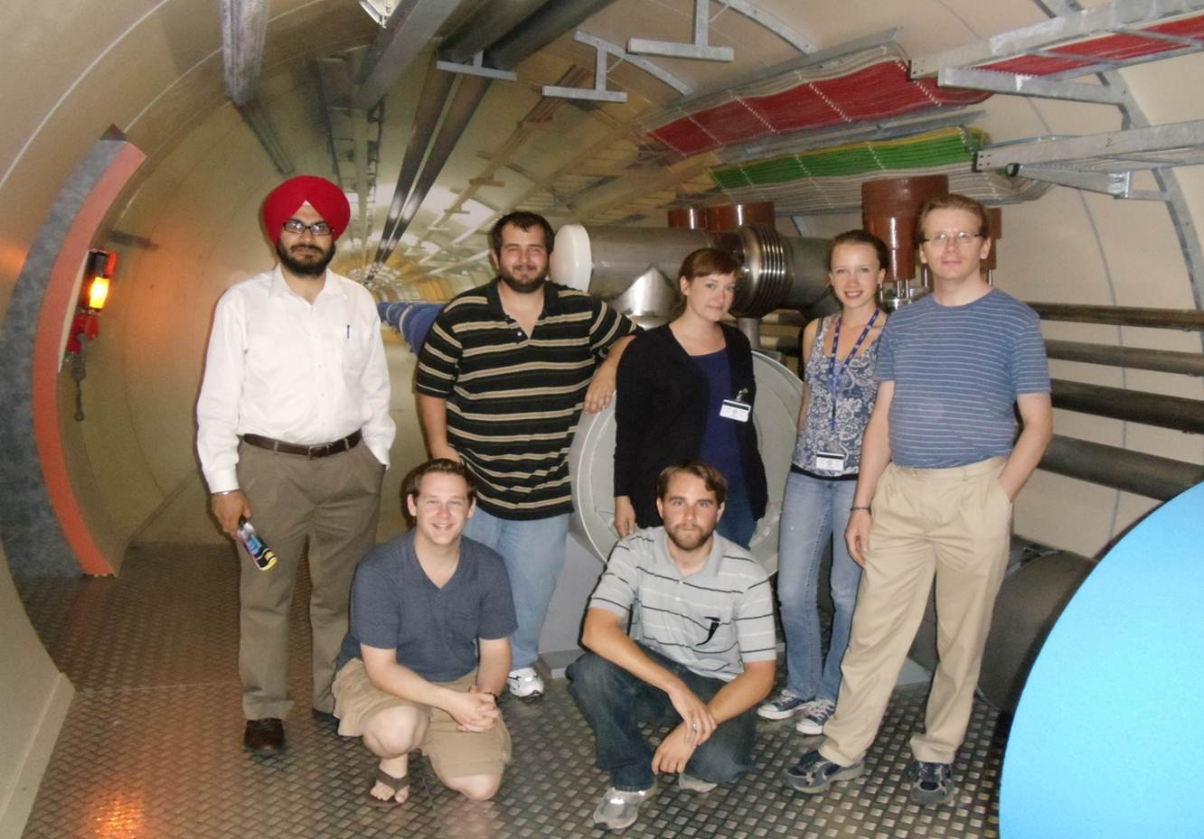
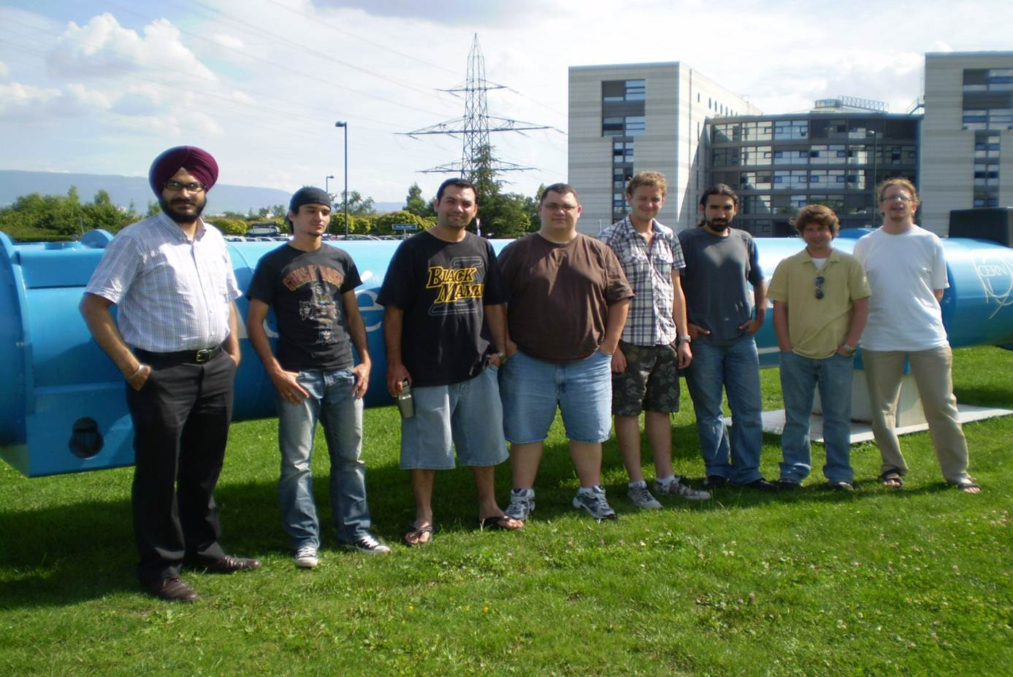
Research possibility for CSU students
Consortium opens up summer research for CSU Students at the LHC or US affiliate sites such as SLAC.
ATLAS – Yongsheng Gao, ALICE – Jennifer Kay, Teaching – Peter Siegel, LHC computing – Cui Lin
Each campus has a liaison: (i) a point of contact for students looking for summer research; (ii) arranges colloquium talks.
The goal – more concrete consortium; more defined and expanded roles for liaison faculty and more benefits (release time, joint grants, etc).
Challenges – funding for student research

Slide 4
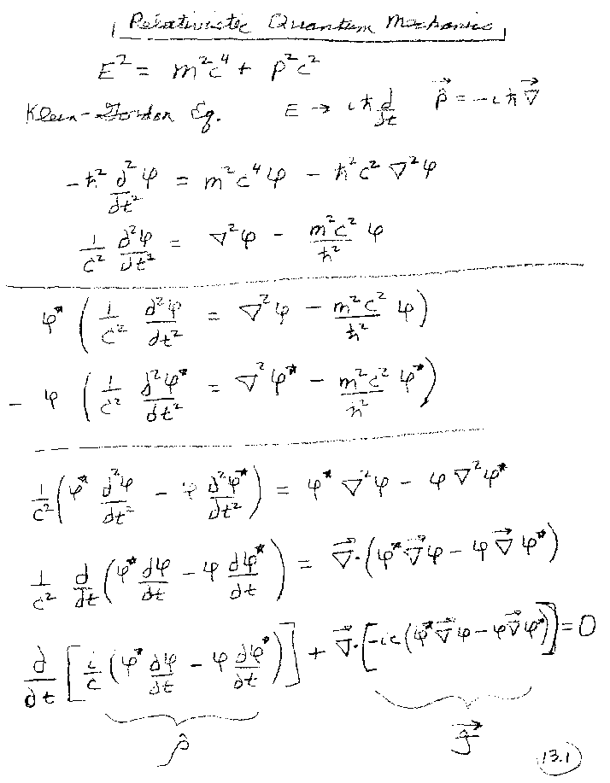
Faculty opportunities
Joint external grant applications – Increase chance to obtain a large NSF/DOE grant. E.G. last years NSF-IRES submission.
Possibility for internal support (release time, summer salary) similar to COAST. http://www.calstate.edu/coast/index.asp
Possibility to teach particle physics courses
that might not run at a single campus.
http://www.csupomona.edu/~pbsiegel/phy404/classnotes.html

