Slide 1
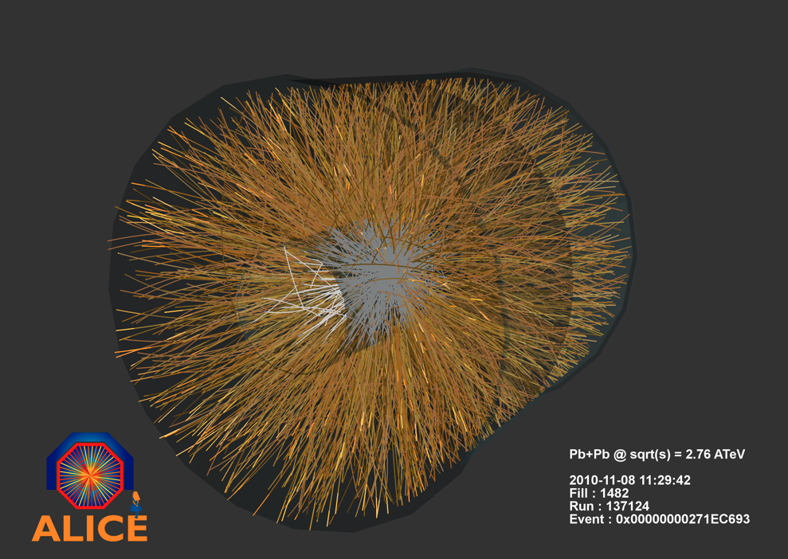
A Large ION Collider Experiment
Jennifer Klay
Cal Poly San Luis Obispo

Slide 2
Goal of ALICE: To Explore the Phase Diagram of Nuclear Matter
Early Universe
Quark Gluon Plasma
Temperature
Neutron stars
Normal Nuclei
Matter Density

Slide 3
Brief History of the Universe

Slide 4
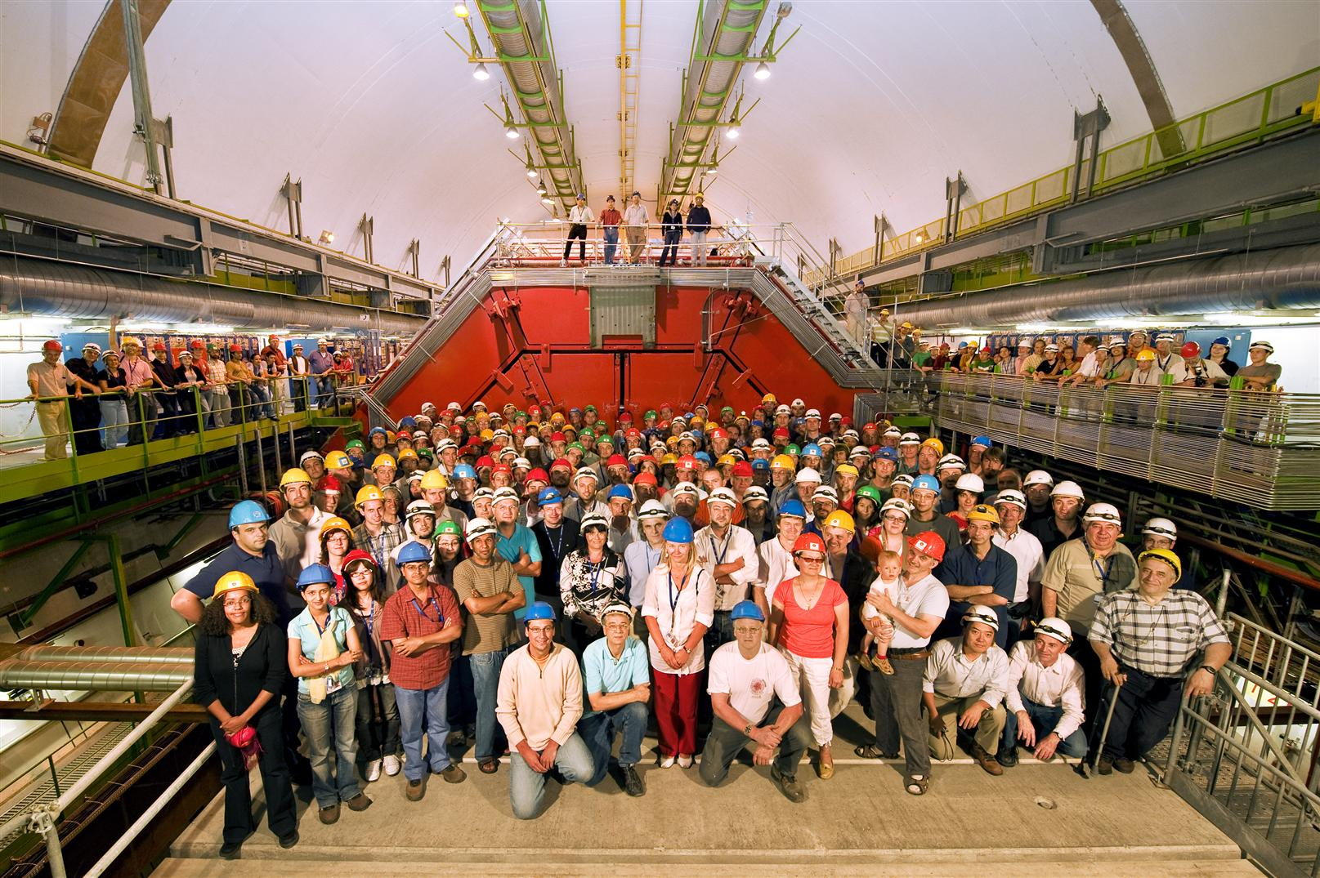
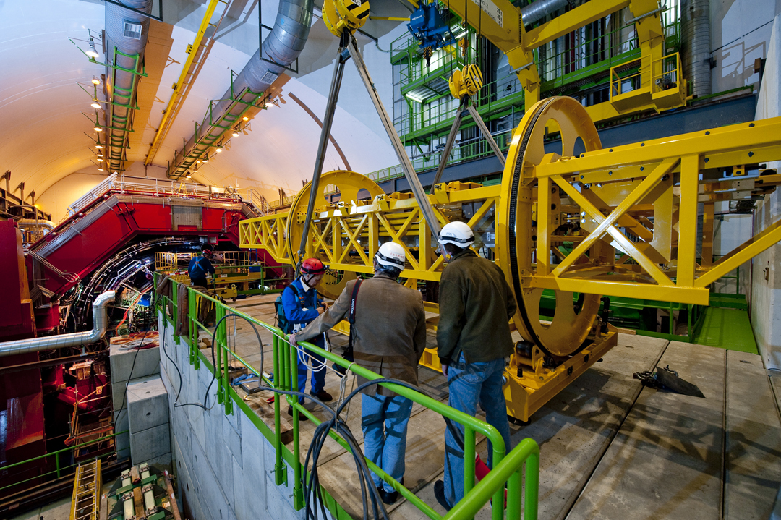
ALICE Collaboration
More than 1,000 physicists, engineers and technicians
Including 200 students
From 111 institutions
In 31 countries
Africa, Americas, Asia, Europe
US in ALICE:
53 physicists, engineers and students
11 universities and laboratories
1 supercomputer center
8 states
Electromagnetic Calorimeter
Funded by DOE Nuclear Science
© CERN

Slide 5
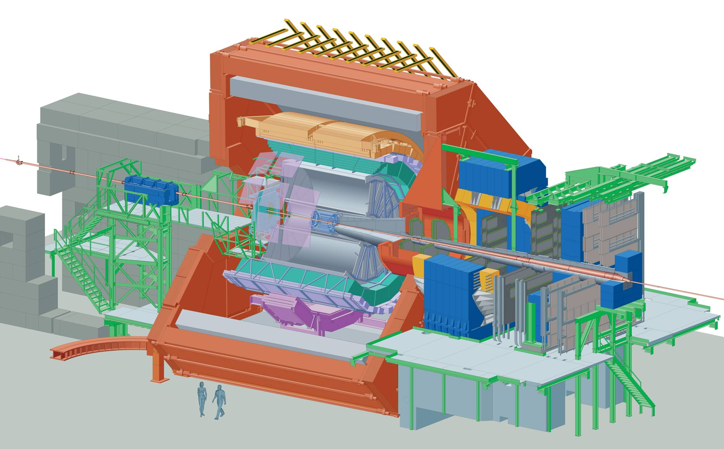
A Large Ion Collider Experiment
Size: 16 x 26 meters
Weight: 10,000 tons
18 different technologies

Slide 6
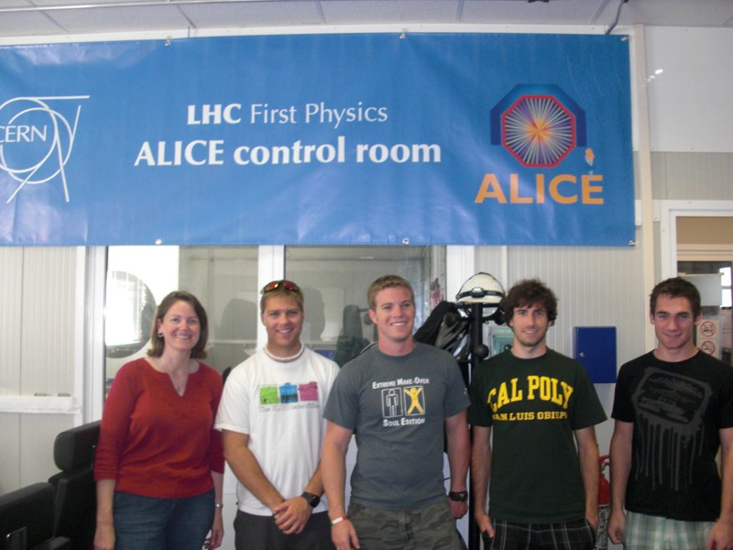
Cal Poly in ALICE
http://nuclear.calpoly.edu/~alice
NSF RUI since 2007 (~$100k/yr)
ALICE M&O ~$10k/year
PI summer salary
1000 student assistant hours
Travel to CERN/conferences
Computers
16 Cal Poly student participants to date (~3/year)
7 Senior projects
NIM A article with Cal Poly student authors
ALICE Electromagnetic Calorimeter
5 presentations at Cal Poly CoSaM research conference
2 posters at APS-DNP CEU (2008)
2 talks at CA-APS Annual Meeting (2009)
Steven Chu Award for best undergraduate talk: Christopher Brown
Physics interests:
Heavy quark energy loss in quark gluon plasma
Comparing properties of electron-tagged jets in p+p and Pb+Pb
Exotica
CHAMPS/Higgs detection with ALICE

Slide 7
Senior projects
http://digitalcommons.calpoly.edu/physsp/
Search for ChaMPs in ALICE
Aleksey Pavlov (in progress)
Development of a quark-level Glauber model of nuclear interactions
Ryan Ward (2011 incomplete)
Could ALICE find the elusive Higgs?
Tyler Williams (2010)
Investigation of Track-Cluster matching vs Track-Cell matching in the ALICE detector at CERN
Kevin Coulombe (2010)
Identification of Bottom Quark Jets in Pb+Pb Collisions in ALICE at the LHC
Brandon Boswell (2010)
Bottom Quark Detection with the Electromagnetic Calorimeter at ALICE
Chris Brown (2010)
Developing a B-jet Tagging Algorithm for ALICE: Lessons from CDF
Paul Carlson (2009)

Slide 8
Other projects
Application of Fastjet for b-tagging (Josh Gearhart 2011)
ALICE massive cosmic flux studies (Patrick McGuire 2010)
EMCAL geometry and alignment validation, track-matching studies, search for charged massive exotic particles (Aleksey Pavlov 2010)
Photon detection with the ALICE EMCAL, data collection for the 2007 EMCAL beam test (Alex Donoghue 2007)
Radiographic imaging of the ALICE detector, data collection for the 2007 EMCAL beam test, EMCAL electronic cable fabrication, development of software definition of ALICE EMCAL support structure geometry (Ryan Ward 2007)
Neutral pion simulation and analysis with the ALICE EMCAL, data collection for the 2007 EMCAL beam test (Scott Lewis 2007)

Slide 9
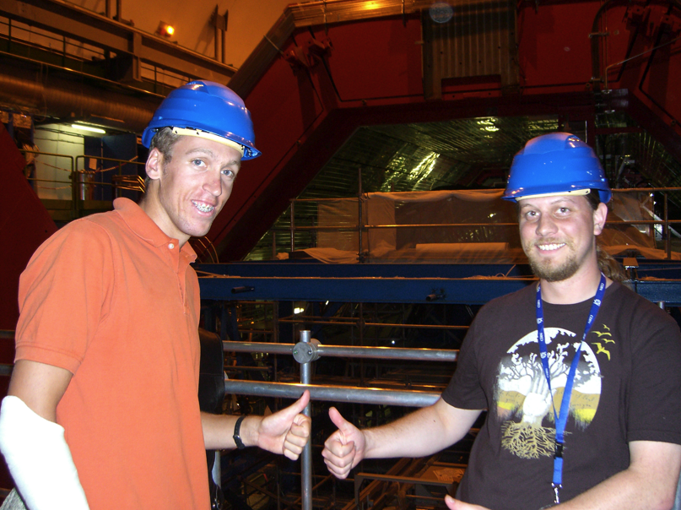
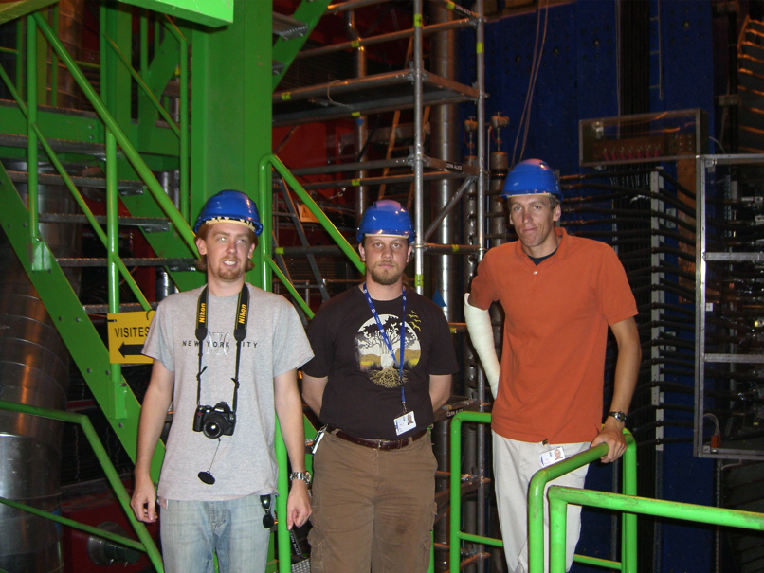
Cal Poly students in ALICE
2007
EMCAL simulations and analysis
3 students, ~8 weeks, 30 hours/wk, $10/hr
EMCAL Beam tests at CERN SPS in Fall 2007
1 week field trip in October to collect data (“learn by doing”)
~$2.5k/person (air travel, hostel, car, per diem)
Work included in the ALICE EMCAL Technical Design Report and NIM article
Students listed in authorship

Slide 10
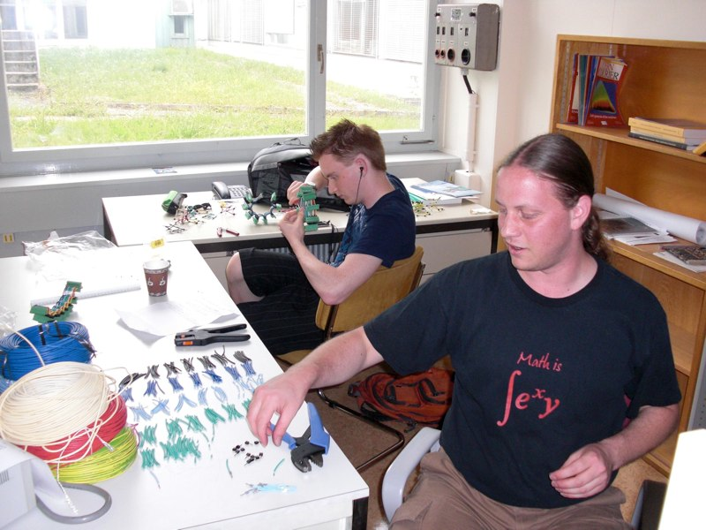
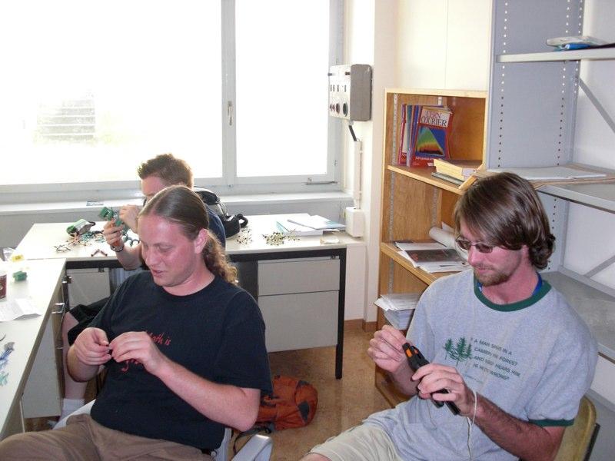
Cal Poly students in ALICE
2008
Development of software definition of geometry for ALICE EMCAL support structure
Simulations for electron-tagged jets
Two week CERN trip (3 students + JLK)
ALICE week, software tutorials, EMCAL cable fabrication
$3k/person (air travel, hostel, per diem)
APS Division of Nuclear Physics Meeting – Oakland, CA – October
JLK on maternity leave
Conference Experience for Undergraduates – Boswell and Brown (poster on b-jets), Ward (poster on Glauber model)

Slide 11
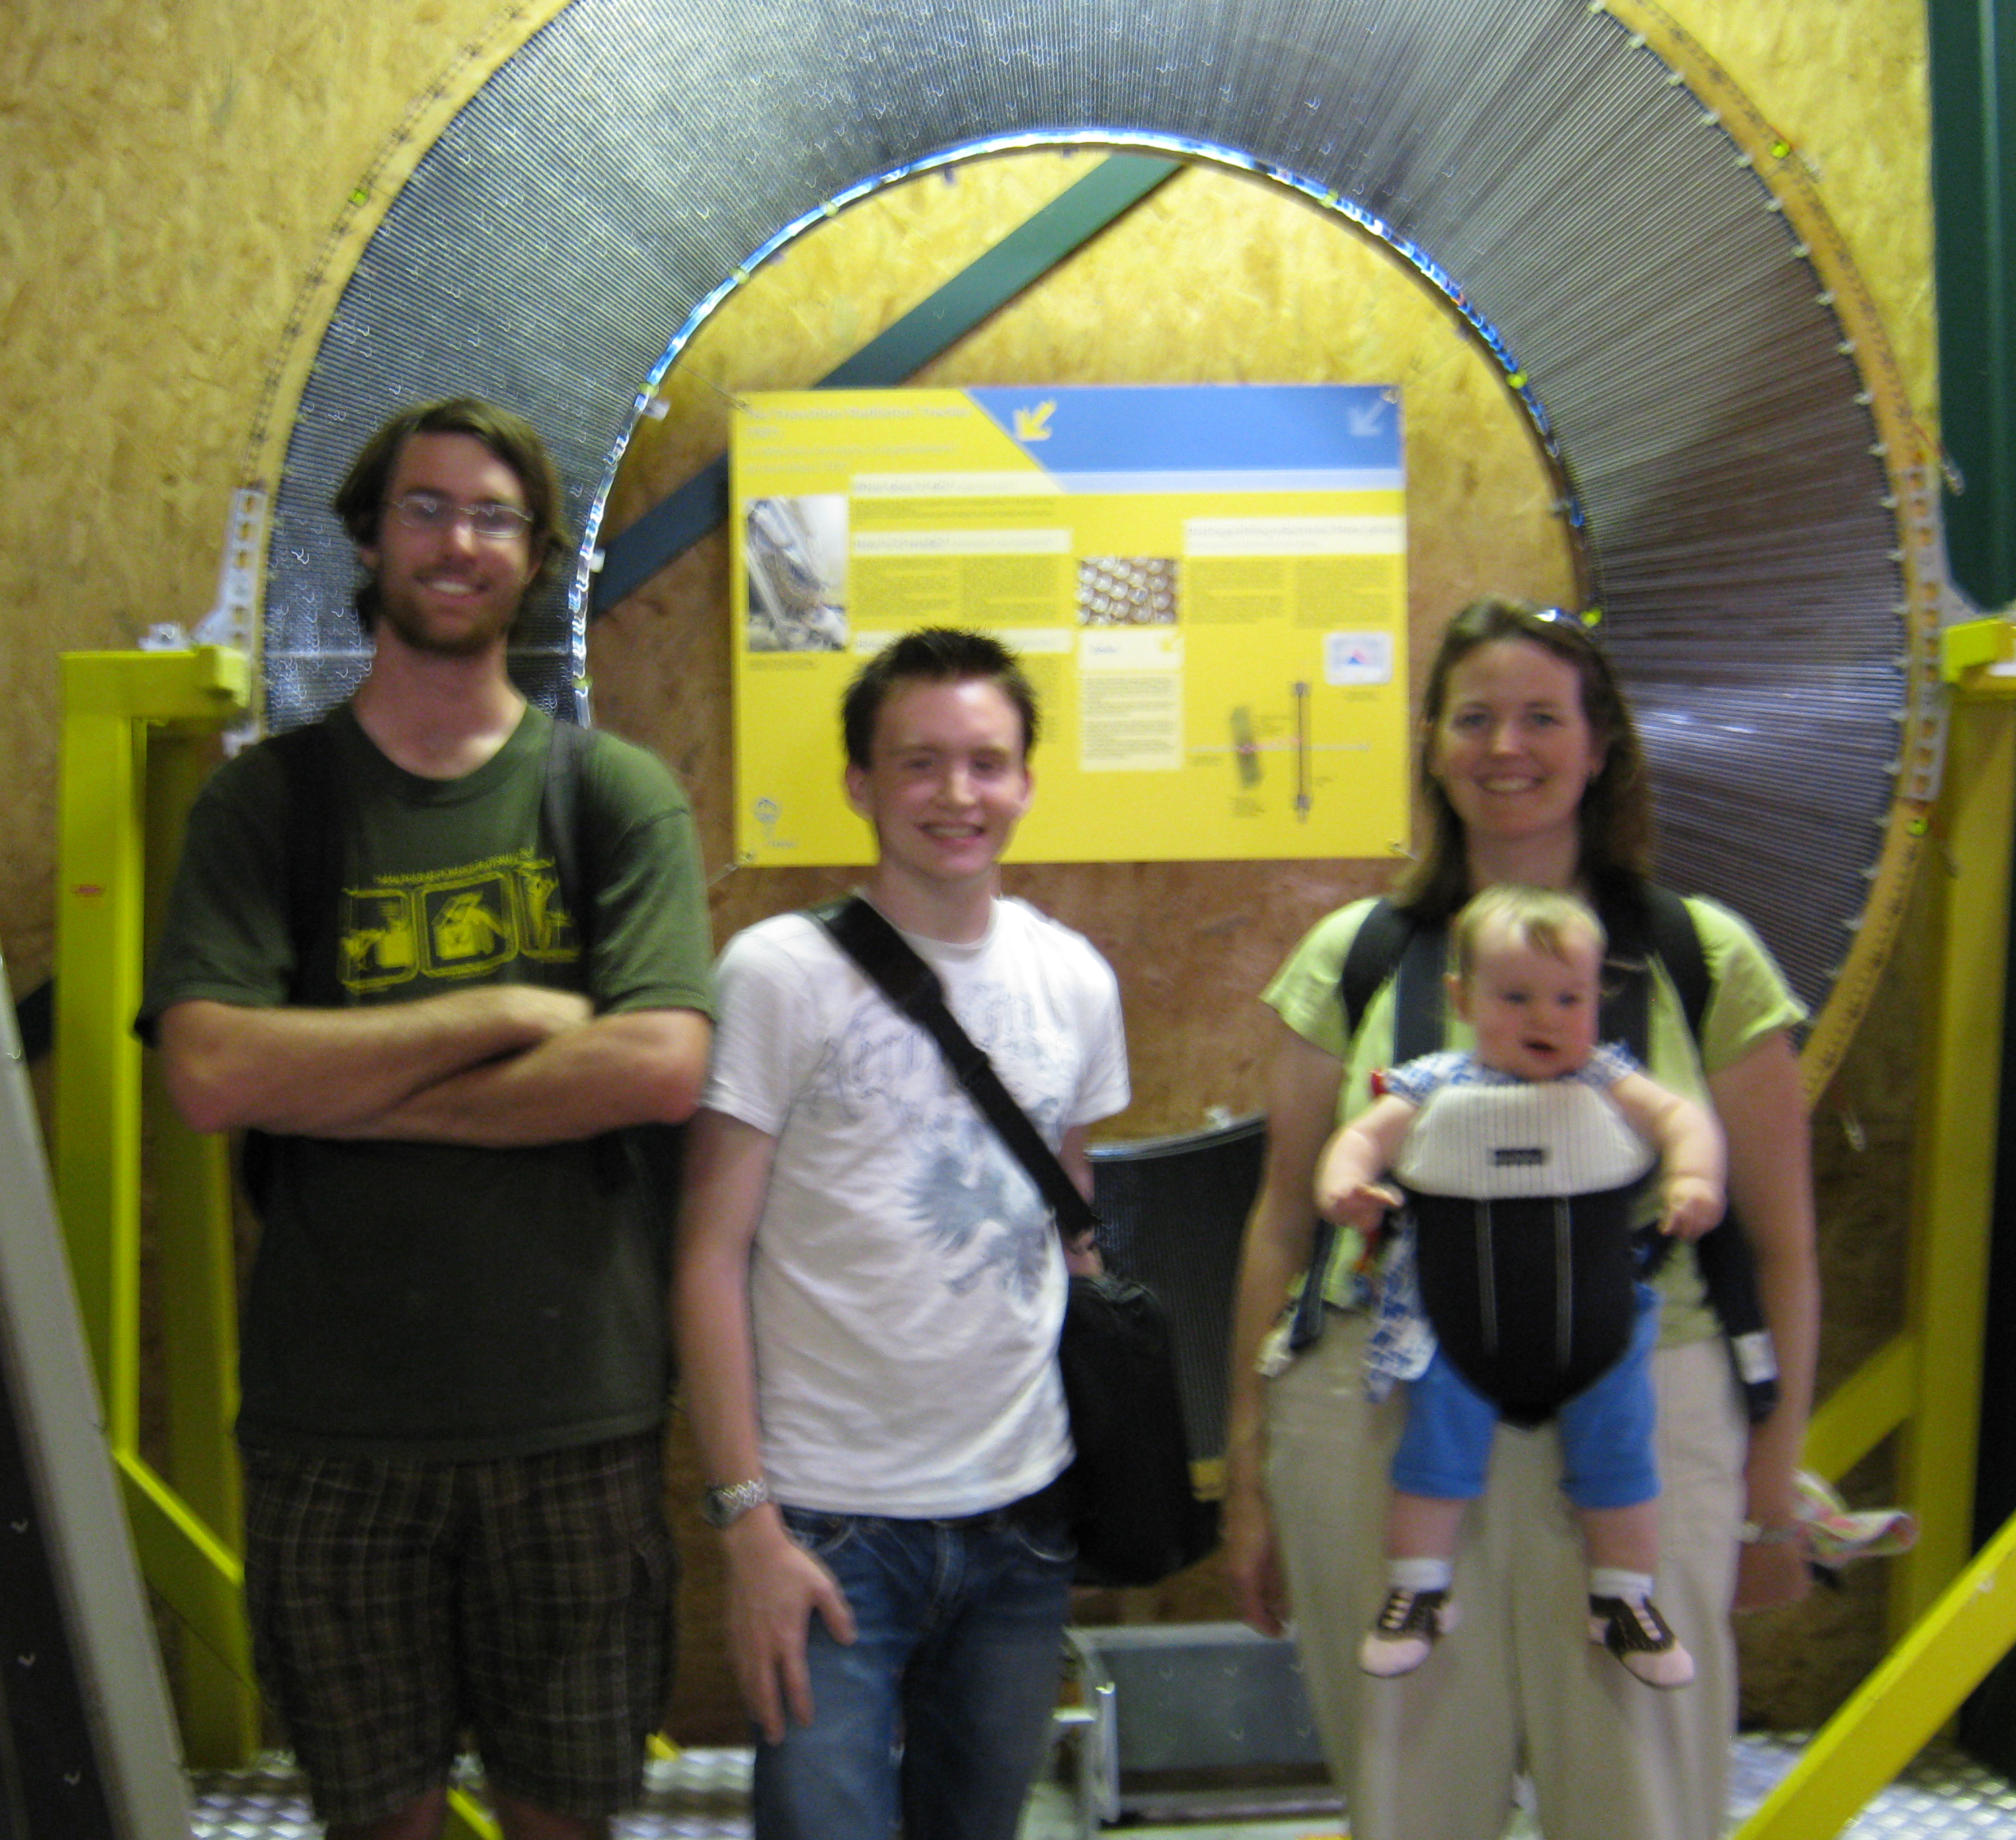
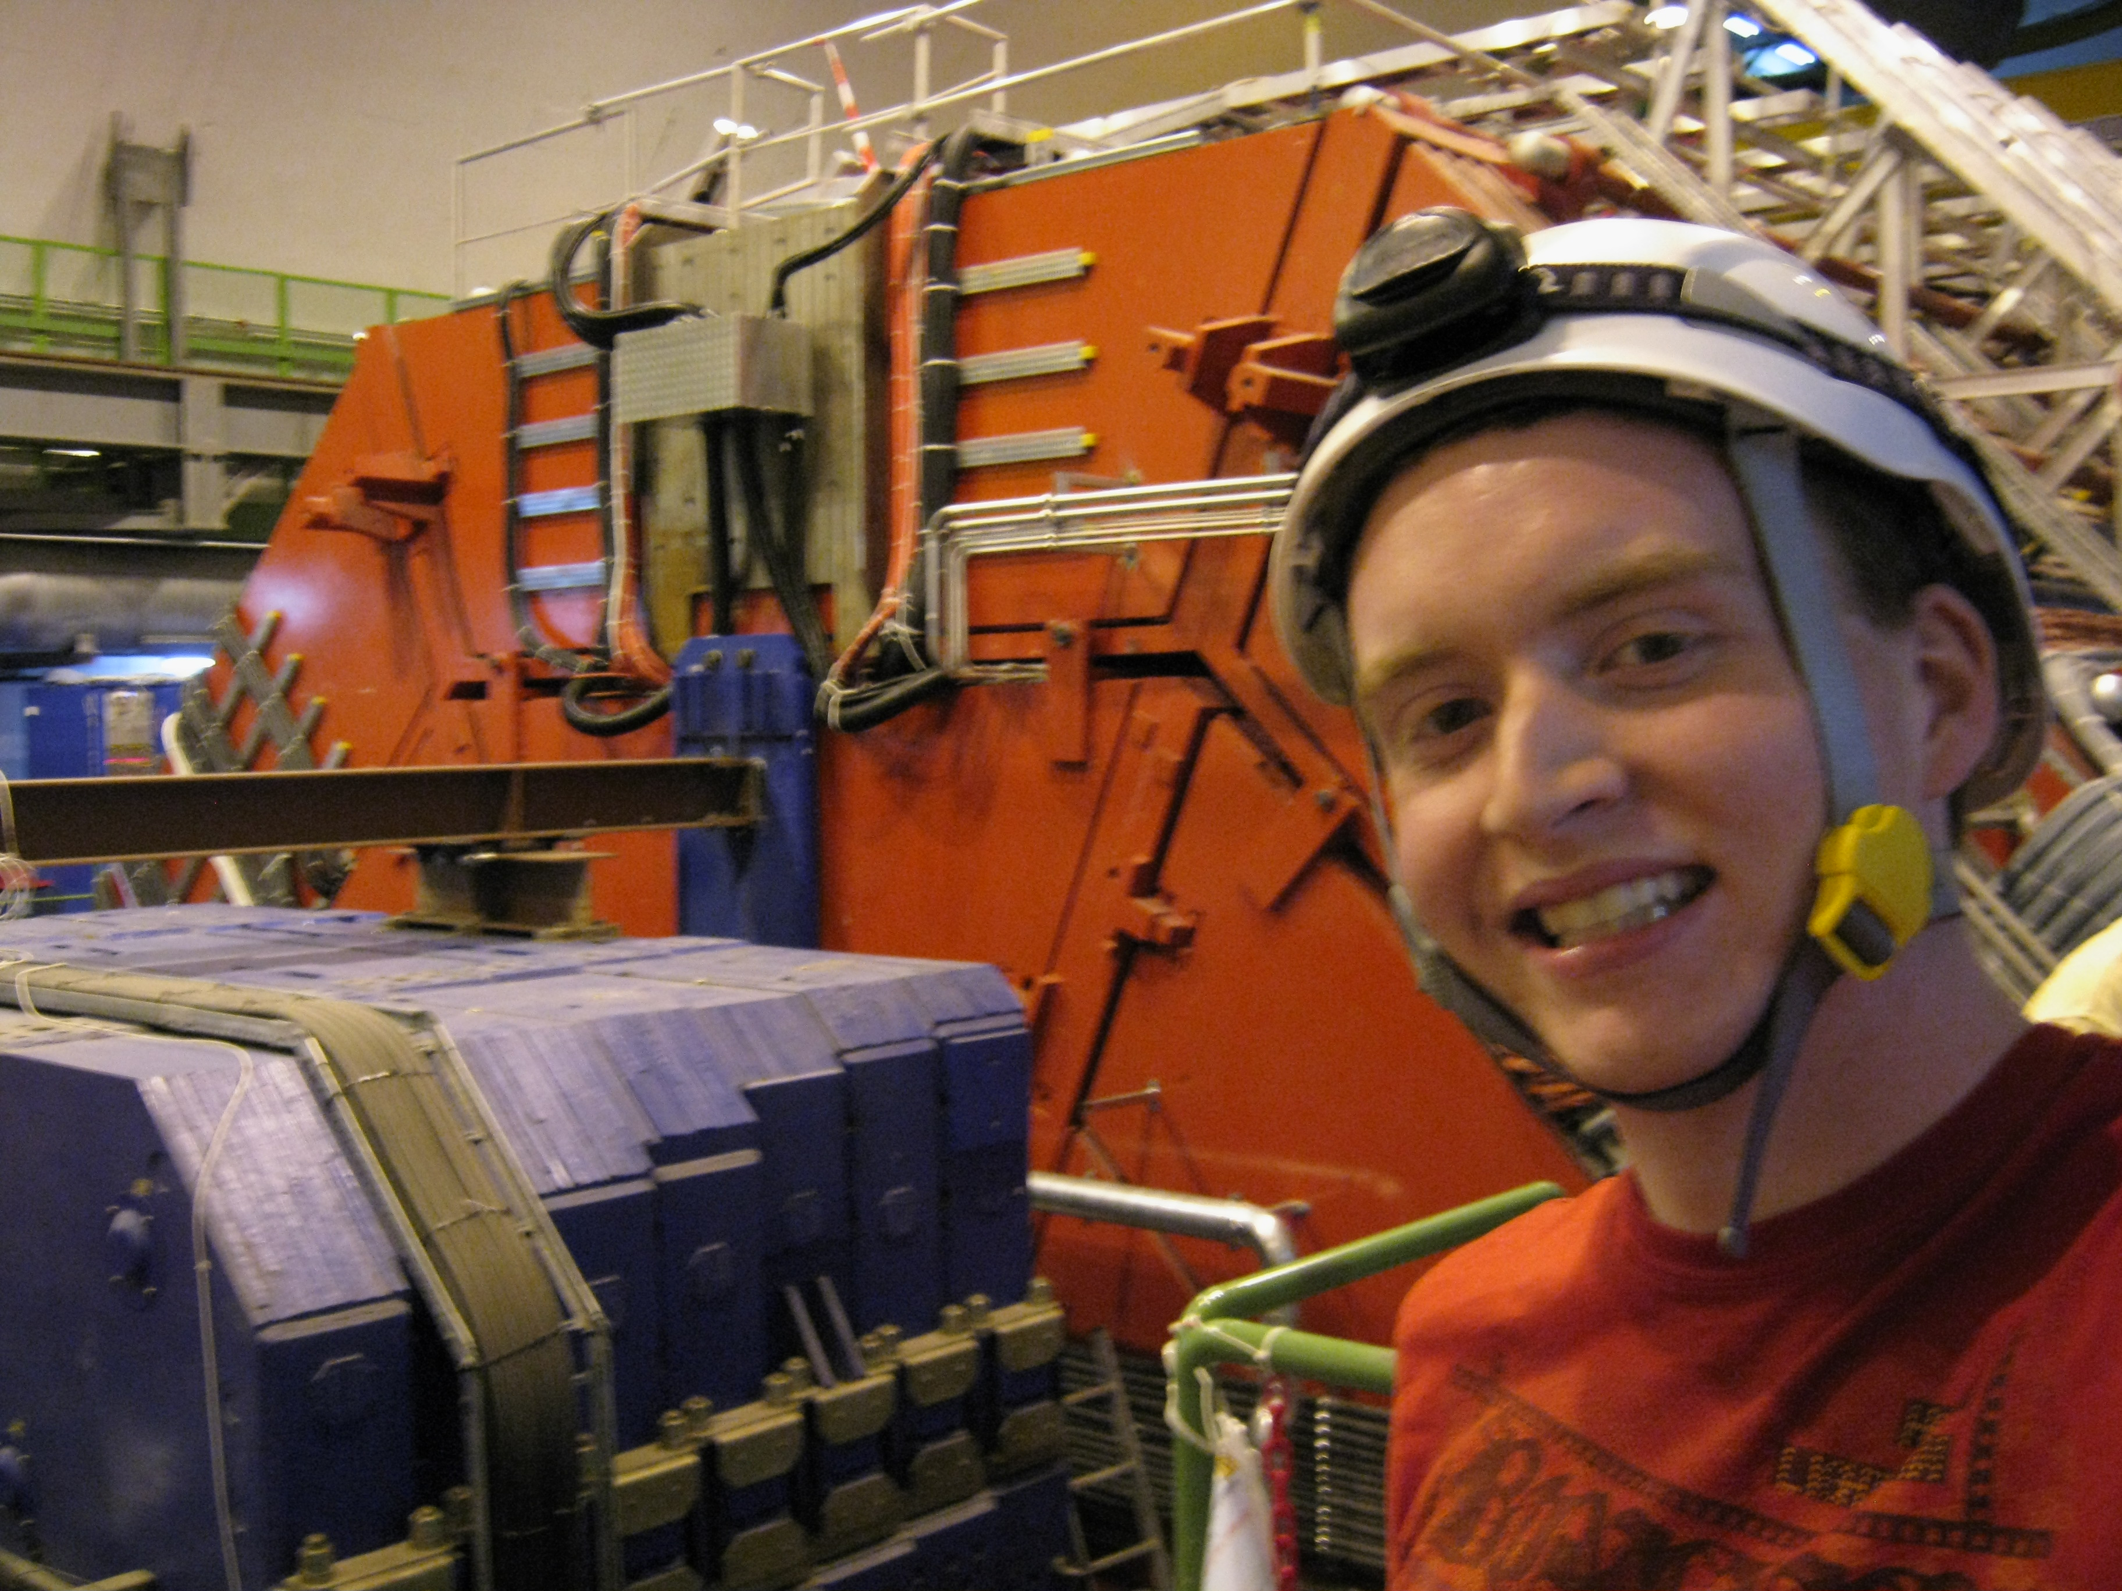
Cal Poly students in ALICE
2009
Electron-jet identification with the ALICE EMCAL
ALICE EMCAL hardware
electronics testing, data quality monitoring software
Students spent ~6 weeks at CERN with local supervisor (~$5k/person)
Shared apartment in Prevessin
Purchased bicycles in Geneva (only lasted one summer ☹)
JLK stayed for 2 weeks ($5k)
CA-APS Meeting – Monterey, CA – November
Boswell: electron identification with ALICE EMCAL, Brown: b-tagging
Brown received Steven Chu Award for undergraduate research
Content

Slide 12
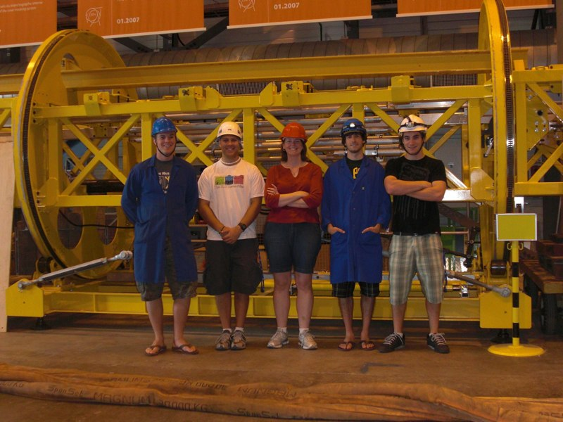
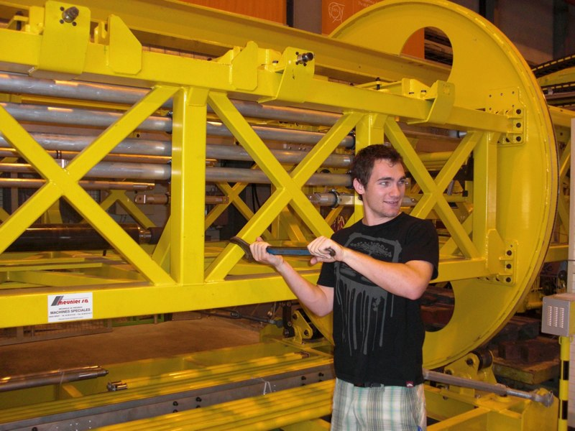
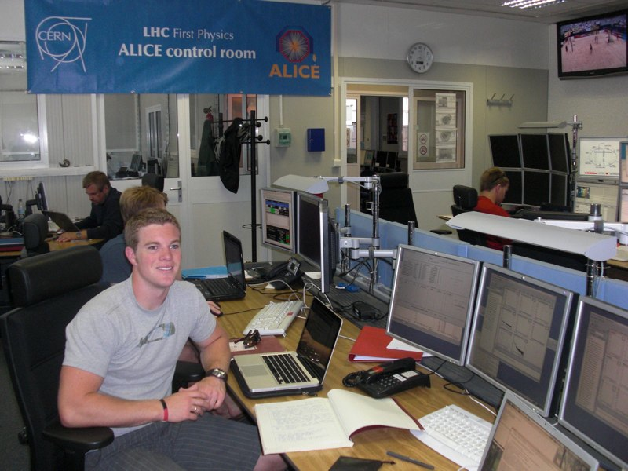
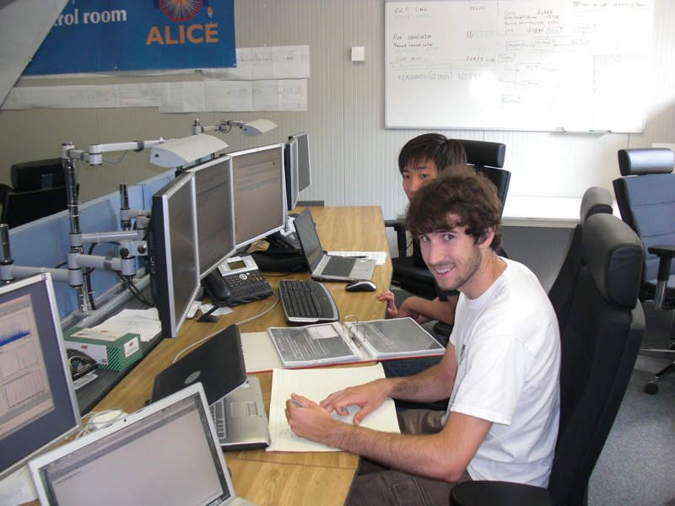
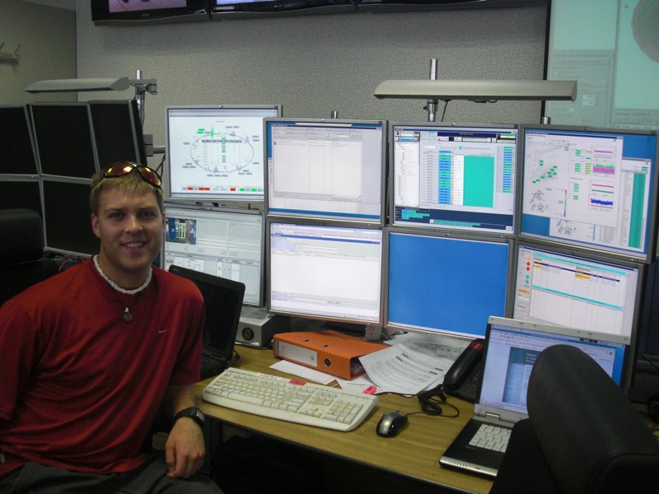
Cal Poly students in ALICE
2010
First data taking shifts at CERN
Four students (8 weeks) plus JLK (2 weeks)
Each student had an analysis project
Weekly skype conference calls with JLK for progress reports, analysis supervision
600% of Cal Poly share of shifts
Students shared apartments in St. Genis
Travel costs: $5k/student, $5k/JLK

Slide 13
Cal Poly students in ALICE
2011
Data-taking shifts at CERN
Four students (4 weeks)
JLK on maternity leave
Returning student from previous summer acted as guide
Minimal supervision of analysis projects = minimal progress ☹
Students shared apartments in St. Genis
Travel costs: $5k/student
Two students went to LLNL for summer internship with ALICE colleagues
One exceeded expectations, one not very productive (lack of computing skills a major factor)
LLNL sent them to CERN for shifts ~2 weeks

Slide 14
Challenges…
Students’ lack of computing skills
Programming
Unix/linux familiarity
Finding time to supervise students
Heavy teaching load (generally)
Low WTU credit for senior projects
No release time for student research during year
Cal Poly physics has no masters degree program
RUI funding for postdoc unlikely
CERN Travel logistics
Costs (summer airfare)
Housing (long-term vs. short-term)
Local supervision for long stays
Bringing student analysis to presentation stage
Students are short-timers
Analysis and internal ALICE vetting are long processes
Since data-taking began, harder to get student talks/posters at conferences

Slide 15
Cal Poly Future plans
Constant level of student interest in LHC
~3-4 inquiries per year
Summer 2012
2-3 students for local analysis projects
Short trip (~1-2 weeks) to CERN for shifts/meetings
NSF RUI renewal due in September 2012
Plan to request 3 more years at similar level
CA-NV APS Meeting at Cal Poly
Consortium participants should plan to attend!
Strengthen pipeline to LLNL
Send more students with better preparation

Slide 16
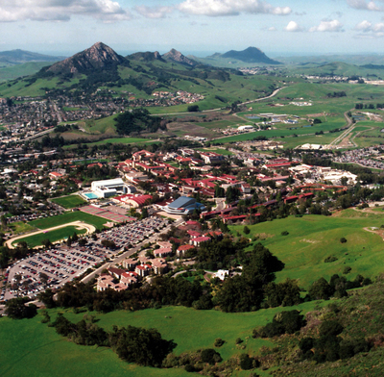
San Luis Obispo, CA
Mark your calendar:
Nov 2-3, 2012
2012 Annual Meeting of the California-Nevada Section

