Slide 1
CSU High Energy Physics Consortium Overview
Why a CSU high energy physics (hep) consortium? – To pool resources and talent of faculty/students across the CSU to have an impact on large experiments on the LHC.
The challenge – To compete with R1s which have more resources lower teaching load.
The answer – By combining resources we hope to use the size of the entire CSU system to compensate for this disadvantage

Slide 2
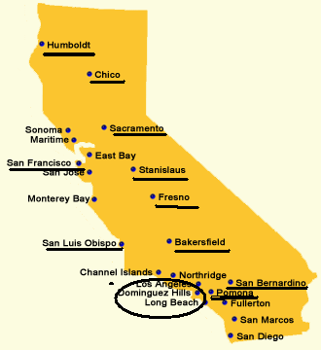
Current configuration of the CSU HEP consortium
Currently there are 13 campuses in the consortium.
Each campus has a liaison: (i) a point of contact for students looking for summer research; (ii) arranges colloquium talks.
The goal – more concrete consortium; more defined and expanded roles for liaison faculty and more benefits (release time, joint grants, etc).

Slide 3
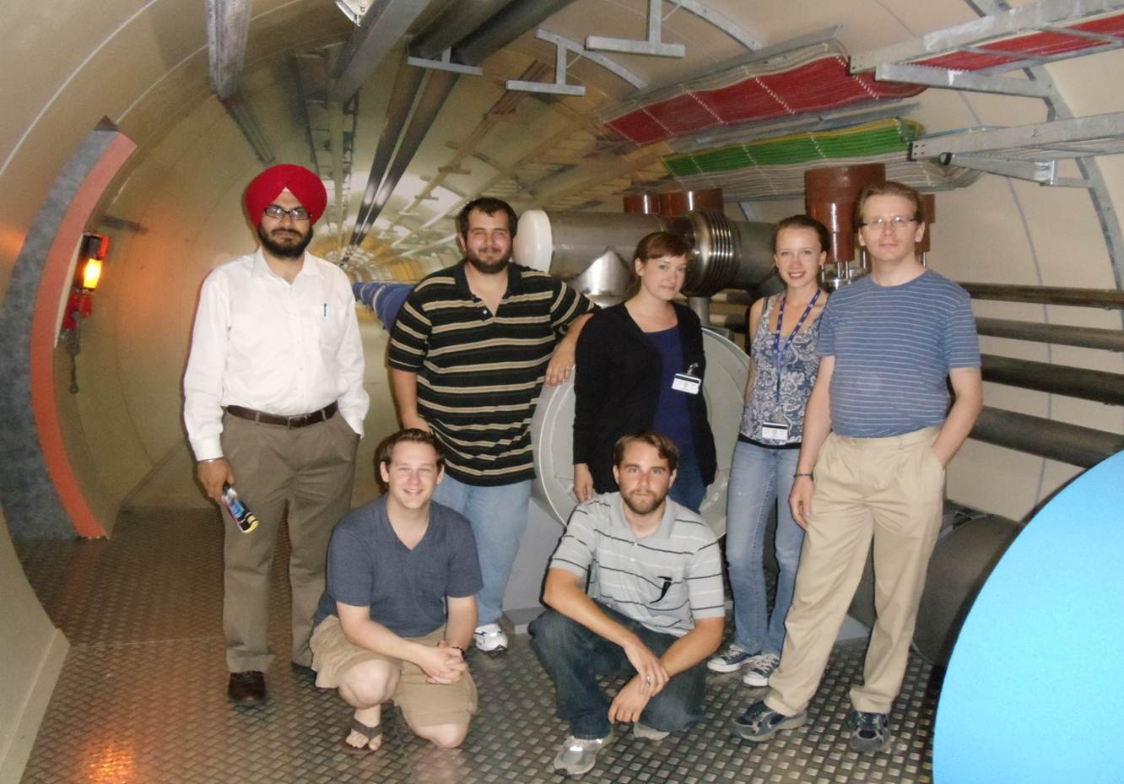
Research opportunities for students
Consortium opens up summer research for CSU Students at the LHC or US affiliate sites such as SLAC.
ATLAS – Yongsheng Gao, ALICE – Jennifer Klay, LHC computing – Cui Lin
Challenges – funding for student research

Slide 4
Faculty research opportunities
Joint external grant applications – Increase chance to obtain a large NSF/DOE grant. E.G. last years NSF-IRES submission.
Possibility for internal support (release time, summer salary) similar to COAST. http://www.calstate.edu/coast/index.asp

Slide 5
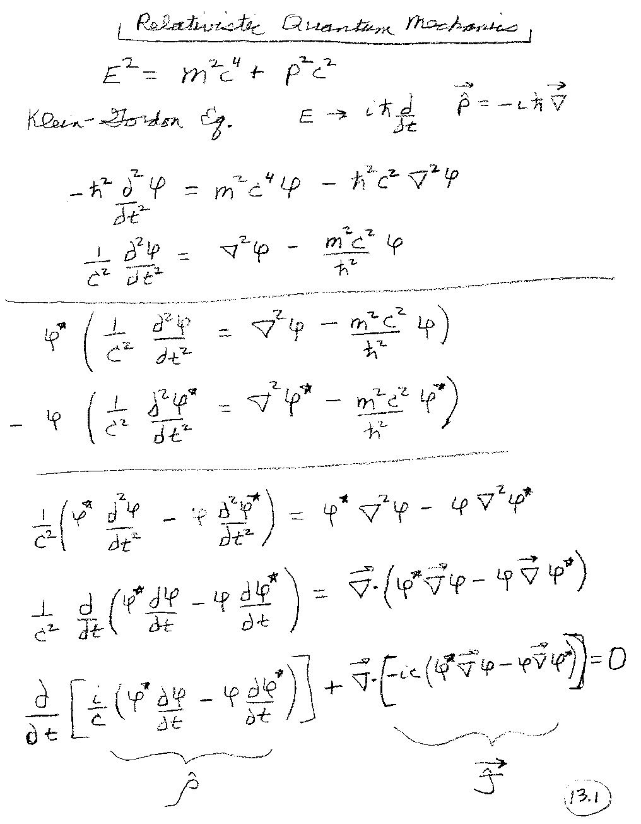
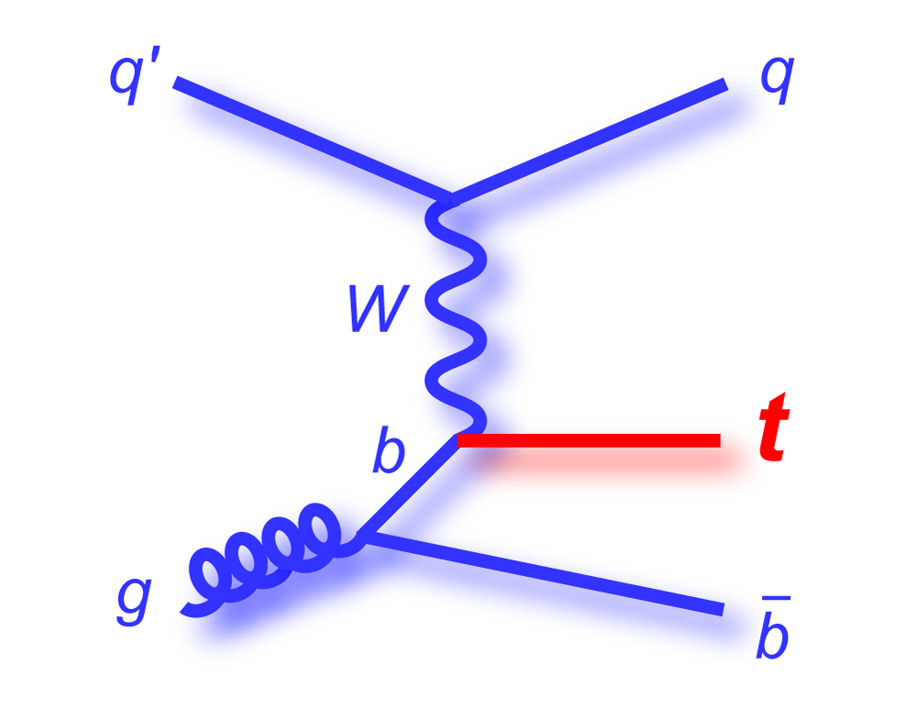
Faculty teaching opportunities
Possibility to teach particle physics/computational courses that might not run at a single campus. For example http://www.csupomona.edu/~pbsiegel/phy404/classnotes.html

Slide 6
Share ideas on research, teaching, funding
By sharing ideas and collaborating we can find what works well at different campuses and try to uses this at our own campus.
Example – IRA funding
I.R.A
Instructionally Related Activities
What are Instructionally Related Activities?
Each student contributes $40 to the IRA fund each semester. These funds are distributed to various programs, events, and projects in which students participate.
The Instructionally Related Activity (IRA) Fee provides funding for activities and laboratory experiences that are partially sponsored by an academic program, discipline, or department and that are integrally related to its instructional offerings. These activities include those which are essential to providing a quality educational program and that constitute a vital and/or enhanced instructional experience for students. Activities funded through this fee shall include, but not limited to, the following: Agricultural Judging, Art Exhibits, Athletics, Drama and Musical Productions, Forensics, Music and Dance Performance, Publications, Radio, Television, and Film Productions.
Eligibility Criteria
To be eligible, activities must: (a) be discipline/departmentally based and sponsored, (b) be integral to course offerings, (c) be intensive, structured activities, (d) require active rather than passive student involvement, (e) engage students in performances, presentations, or competitions that demonstrate skills from participation in intensive class work
http://asi.csufresno.edu/index.php/funding/ira

